Slide 1
Network Video Recorder
User’s Manual
iN-Lite04M
iN-Lite08M
iN-Lite16W

Slide 2
Thank you for using our product.
This is user's manual for NVR(Network Video Recorder).
This manual contains product specification and introduction, installation guide, operating guide and other necessary matters for easy understanding. Users should read this user's manual carefully for proper use.
Contents in this manual may be changed according to the specification change and feature improvement without any notification.
4. This user's manual shall never be copied without prior agreement and violating this may be a reason for legal punishment on piracy.
5. If there is any incorrect or insufficient content in this user's manual, notify it to Customer Support Center.

Slide 3
CONTENTS
Contents
CH 1. Product Introduction`
1-1. Product Contents 5
1-2. Product Characteristics 6
1-3. Name of Each Part 8
CH 2. Installation Guide and Cautions
2-1. Cautions 12
2-2. Product Installation 15
2-2-1. Power Connection 15
2-2-2. Connecting External Device 15
CH 3. How to Use
3-1. General Usage Information 18
3-2. Live Mode 20
3-2-1. Live mode control 20
3-2-2. Live mode feature 23
3-3. Search Mode 33
3-3-1. Search selection type 35
3-3-2. Play Mode 39
3-4. Setup Mode 40
3-4-1. Display 40
3-4-2. Record 42
3-4-3. Device 50
3-4-4. Alarm 61
3-4-5. Network 72
3-4-6. System 77
3-5. Firmware Upgrade 84

Slide 4
CONTENTS
Contents
Trouble Shooting 86

Slide 5
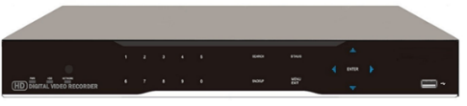
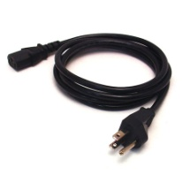
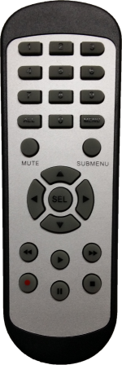
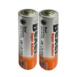

CH 1 Product Introduction
CH1. Product Introduction
1-1. Product Contents
After removing packing materials of this product, check whether all following contents are included.
Main Body (NVR):
This converts the analog video and audio signal to the digital signal and saves on HDD.
Adapter(or POWER CABLE only for 16ch):
This 48V adapter supplies power or power cable to the product.
MOUSE:
This is an controller for convenience.
Remote Controller:
This is an IR remote controller for convenience.
Battery:
These are 2(two) battery for the remote controller.

Slide 6
CH 1 Product Introduction
1-2. Product Characteristics
1) High quality picture
This enables recording and playing high quality digital image.
2) High reliability
With Embedded hardware and software design, this maintains higher product
reliability.
3) Simple usage
This allows users to use it conveniently by placing control buttons similar to existing ones on VCR, and users can easily learn the usage.
4) Pentaplex System
Pentaplex System allows live, recording, backup, networking and playback simultaneously.
5) Selectable recording setup
For recording methods, users can select the frame rate, resolution and video quality individually in order to be appropriate for user's environment.
6) Remote monitoring
With using exclusive line or Internet network, you can search or monitor recorded images remotely by installing exclusive client program on Windows PC or Mac.
7) Backup
You can backup with a versitile external USB devices.
8) Audio recording
You can record all sound inputs simultaneously. Moreover, you can listen to the sound in search and live monitoring and play mode.
9) Various recording methods
This provides convenient use with manual recording, recording by dates and days, hourly schedule recording, sensor and motion detection event recording and
others to enable unmanned monitoring.
10) Various total monitoring features
You can cover any security scenario through various sensor inputs and contact
output control.

Slide 7
CH 1 Product Introduction
11) Display information in easy-to-understand information method
This enhanced convenience of user by displaying information (date, time, recording method, recording frame number, HDD capacity and others) in monitoring, recording and playing mode in easy-to-understand way.
12) P/T/Z control
By built in RS485, various P/T/Z cameras can be used.
13) Dual CODEC for video transmission
DVR can send 120 fps (based on CIF) regardless of the local recording and viewing setup regardless with recording setup.
14) Web browser support
You can monitor and playback the video and control the PTZ camera by internet explorer.
15) Built in S.M.A.R.T.
You can automatically check the health of the hard disk drives.
16) Language pack
Basically DVR has multiple language set, furthermore you can choose the language set if you want.
17) Spot monitoring
Spot out can be enable to monitor sequentially in other place.

Slide 8
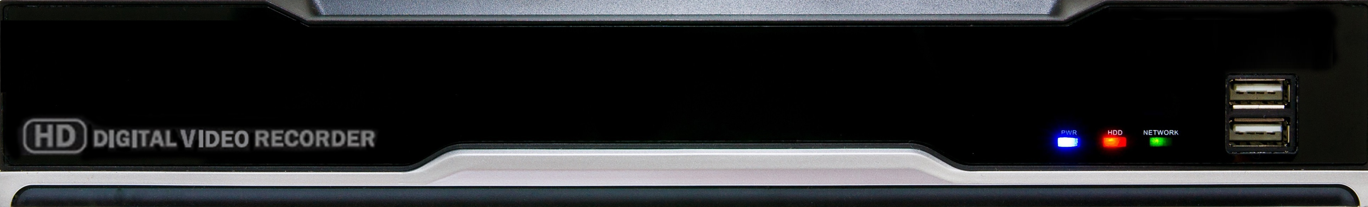
CH 1 Product Introduction
1-3. Name of Each Part
[Front Panel]
<iN-LITE 04/08M>
3. IR RECEIVER
2. STATUS RAMPS
1. USB
1. USB : These USB ports are for mouse and USB devices. You should
connect correctly the USB devices and mouse as picture directed.
2. Status lamps
POWER : Blue color back light. Power indicator.
RECORD : Red. Indicate the recording.
NETWORK : Green. Lit on connecting the network
Red and green flashing alternately after boot
– Hard disk is not recognized or formatted.
Red and green flashing simultaneously without booting
– please contact service center.
3. IR RECEIVER : It is for remote controller.

Slide 9
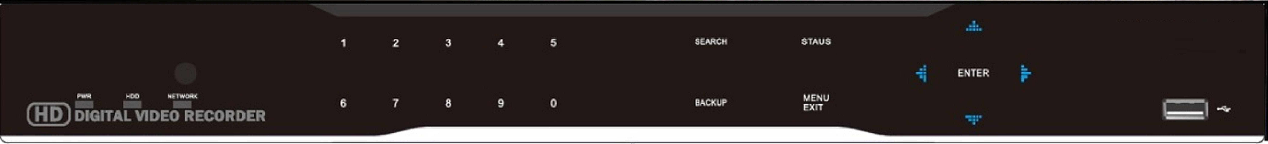
CH 1 Product Introduction
[Front Panel]
<iN-LITE 16W>
3. IR RECEIVER
4. Number Buttons
5. Function Keys
2. STATUS RAMPS
1. USB
1. USB : These USB ports are for mouse and USB devices. You should
connect correctly the USB devices and mouse as picture directed.
2. Status lamps
POWER : Blue color back light. Power indicator.
RECORD : Red. Indicate the recording.
NETWORK : Green. Lit on connecting the network
Red and green flashing alternately after boot
– Hard disk is not recognized or formatted.
Red and green flashing simultaneously without booting
– please contact service center.
3. IR RECEIVER : It is for remote controller.
4. Number buttons : If you press this button, it will be changed to full screen in live viewing or playback If you want to go to 16ch, push the 0 and 6.
(※ In menu and password setting, it is automatically converted to number buttons)
5. Function keys
1) MENU : It will move to the setup screen from the live mode.
2) SEARCH : It will change to the playback mode from the live mode.
3) BACKUP : It will move to the backup screen from the live or play mode.

Slide 10
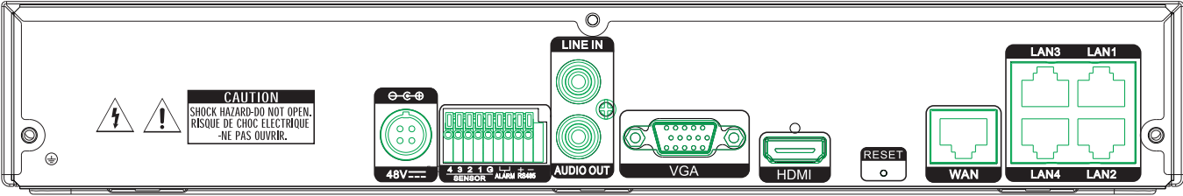
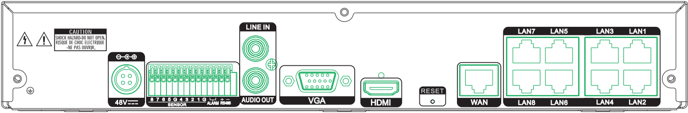
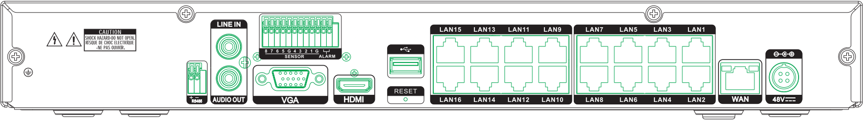
CH 1 Product Introduction
[Rear Panel]
<4 CH>
2.SENSOR IN
/ RELAY
/ RS485
6.HDMI
8. POE PORTS
4. AUDIO IN
1. POWER INPUT
3. AUDIO OUT
7. WAN
5. VGA
<8 CH>
2.SENSOR IN
6.HDMI
/ RELAY
8. POE PORTS
/ RS485
4. AUDIO IN
1. POWER INPUT
3. AUDIO OUT
7. WAN
5. VGA
<16 CH>
4. AUDIO IN
6.HDMI
2.SENSOR IN
2. RS485
/ RELAY
8. POE PORTS
5. VGA
9. USB
7. WAN
1. POWER INPUT
3. AUDIO OUT

Slide 11
CH 1 Product Introduction
POWER INPUT
SENSOR IN : This terminals can be connected to external sensors.
RELAY : This terminal blocks connect external electric devices to the
product (Warning Lamp and others).
RS485 : For control the pan and tile cameras. Make sure that the polarity.
AUDIO OUT : RCA audio out terminal.
AUDIO IN : RCA audio in terminals.
VGA : video output for VGA display.
HDMI : Display output for high resolution monitor.
WAN : This is the Gigabit Ethernet LAN cable connection terminal for
NVR.
POE PORTS : POE connection terminal for IP Cameras.
only for 16ch
USB : USB port for mouse and USB devices.
For more details, refer to [CH 2. Installation Method and Cautions].

Slide 12
CH 2 Installation Method and Cautions
CH2. Installation Method and Cautions
2-1. Cautions
WARNING
Risk of electric shock.
Do not open the cover of the product.
Servicing of this product by unauthorized personnel is prohibited and will result in a void of warranty.
In order to ensure the most stable conditions for power, the use of a UPS (Uninterrupted Power Supply) is recommended.
- Avoid installing the product where there are direct rays or it is hot by locating near from heat generator. (May cause fire)
- Do not put vase, flowerpot, cup, cosmetics, drug, and anything the contain water on product. (May cause fire or electric shock, and it may injure people by falling)
- Do not insert or drop any metal object (coin, hair pin) or flammable object (match, paper) into air hole. (May cause fire or electric shock)
- Do not put any heavy object on it. (May injure people by being fell or destroyed.)
- Put power plug surely not to be moved. (If not, this may cause fire.)
- Unplug power plug and antenna when there are thunders and lightening. (May cause fire.)
- For cleaning the product, wipe surface with dry towel. Using chemical agent or cleaner may change the color and unpeel paint. Do not put several plugs at same time. (May cause electric shock.) If there is smoke or strange smell, stop operation. In this case, turn the power off and unplug it, and then contact our service center. (If you keep using it, this may cause fire or electric shock.)
- Do not unplug by pulling cord. (If cord is damaged, it may cause fire or electric shock.)
- Do not plug or unplug with wet hands. (May cause electric shock.)

Slide 13
CH 2 Installation Method and Cautions
- Keep the power cord untwisted. (May cause fire or electric shock.)
- Use proper adapter. (Using too much electric power may cause fire or electric shock.)
- Do not install it at where exposed to rain and wind and water drop. (May cause fire, electric shock and transformation.)
- Keep away from fire. (May cause fire.)
Do not disassemble or remodel on your own. (May cause malfunction or electric shock.)
- Do not put next to flammable materials like flammable spray. (May cause fire.)
- Do not install it at a place with too much dirt. (May cause fire.)
- Do not install it on unstable places like shaking table and inclined place or shaking place. (May injure users by falling down or being upside down.)
- Do not put an heavy object on power cord or avoid it from being pressed by the device. (May cause fire or electric shock.)
- In case of using extension cord, do not use several devices at same time. (May cause fire with abnormal heating of extension.)
- When there are dirt on power plug pin or power outlet, clean it nicely. (May cause fire.)
Do not damage on power cord or plug, and bend or twist or pull too much, and put it between other objects or heat. If power outlet insertion part is not tight, do not use it. (May cause fire or electric shock.)
Do not drop or give a shock to the product. (May injure people or cause malfunction.)
- Do not touch power adaptor or signal controller. (May cause electric shock.)
- Do not put any object too close to block cooling fan. (May cause fire.)
- In case of exchanging batteries with improper type, there might be danger of explosion.
- For used batteries, throw away separately from other garbage.
- When you take out batteries, avoid children from eating them by mistake. Keep them away from children. (If a child ate them, contact a doctor right away.)

Slide 14
CH 2 Installation Method and Cautions
Note :
This equipment has been tested and found to comply with the limits for a Class A digital device, pursuant to part 15 of the FCC Rules. These limits are designed to provide reasonable protection against harmful interference when the equipment is operated in a commercial environment. This equipment generates, uses and can radiate radio frequency energy and, if not installed and used in accordance with the instruction manual, may cause harmful interference to radio communications. Operation of this equipment in a residential area is likely to cause harmful interference in which case the user will be required to correct the interference at his own expense. Changes or modifications to this equipment may cause harmful interference unless the modifications are expressly approved in the instruction manual. The user could lose the authority to operate this equipment if an unauthorized change or modification is made.
This device complies with the part 15 of the FCC Rules. Operation is subject to the following two conditions : (1) this device may not cause harmful interference, and (2) this device must accept any interference received, including interference that may cause undesired operations.
FCC Warning :
This equipment may generate or use radio frequency energy. Changes or modifications to this equipment may cause harmful interference unless the modifications are expressly approved in the instruction manual. The user could lose the authority to operate this equipment if an unauthorized change or modification is made.
CE Warning : This is a Class A product. In a domestic environment this may cause radio interference in which case the user may be required to take adequate measures.
This product has obtained EMI registration.

Slide 15
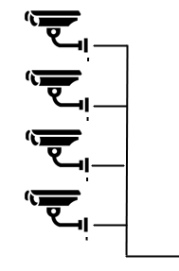


CH 2 Installation Method and Cautions
2-2 Product Installation
This product may be composed of camera and monitor in default, and additionally the sensor, microphone, speaker and PC for network can be connected if necessary.
2-2-1. Power Connection
1) Connect adapter or power cable to power input terminal at rear side.
(free voltage from 100V to 240V, 50/60Hz)
※ You must operate it at the rated voltage instructed on the user's manual. In case power higher than the rated voltage is supplied, it may cause damages on product.
2-2-2. Connecting External Device
※ Connect it when power of the product is off.
※ Read through user's manual for the device you are connecting carefully.
1) How to Connect External Video/Audio Device
IP CAMERA
MIC
Connect cameras to POE PORTS by channels.
Connect microphone (AMP) to AUDIO IN by channels.
Connect Display output to HD Monitor.
Connect AUDIO OUT to AUDIO IN of monitor (or speaker).

Slide 16

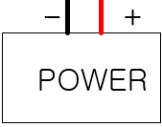

CH 2 Installation Method and Cautions
2) How to connect external sensor
Sensor terminal is composed of 1 input channel and 1 output channel. Sensor out terminal is relay output with 1A, 24V or 0.5A,125V.
SIREN
SENSOR
Sensor In : Connect the sensors. The sensor are composed of both signal and ground terminals, with a voltage difference of 5V. In the case that the sensor used for input is of the N/O (Normal Open) type, when the voltage difference between the signal and ground falls to 0V (short), the DVR can use this as a trigger to start alarm/sensor based recording.
Sensor Out : Connecting external electrical devices
The relay output terminal does not provide power, and functions only on an ON/OFF basis via a relay. Normally, the signal and ground should be on an OPEN basis, and the DVR will complete the relay connection.
3) Connecting with PC using LAN cable
If you want to connect DVR to PC directly, use LAN cable, and if you want to
use HUB, connect cable via hub.
*Hub : This is a device connecting one office to devices located near with
using cable when you organize LAN
*Cable : This is standard UTP cable used for communication among
devices through Hub and others when you organize LAN
PC
HUB

Slide 17
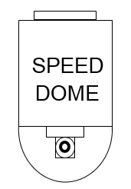
CH 2 Installation Method and Cautions
4) Connection Using PTZ camera
In case of using pan and tilt cameras, connect PAN/TILT DRIVE to product
as shown at following figure.
POE
RS 485 CABLE
5) Installing Hard disk drive
In case of installing the hard disk drive, open the upper case and install the hard disk drive on the hard bracket. Remember that the main power should be off to install the hard disk drive. If you have any trouble, please contact the technical support.

Slide 18
CH 3 How to Use
CH3. How to Use
3-1. General Usage Information
This DVR can be operated with a mouse or remote controller under the four main modes listed below:
Live Mode – This is the “main or default” mode. From this mode you can view in real time all currently operating cameras, information regarding camera status, and have access to Pan/Tilt camera controls. In addition, system status information will be shown during live mode, and other modes can be entered from Live mode.
Setup Mode – The user will be able to customize settings for Live viewing, Recording, Backup, and Camera related devices under the Setup Mode.
Search Mode – In Search Mode, the user will be able to review all recorded footage in the case that an event must be reviewed using a calendar or event based search.
Backup Mode – In Backup Mode, the user will be able to archive the desired data to the preferred supported media of their choice (ex. External CD&DVD RW, USB Backup, Remote Client Software, etc.)

Slide 19
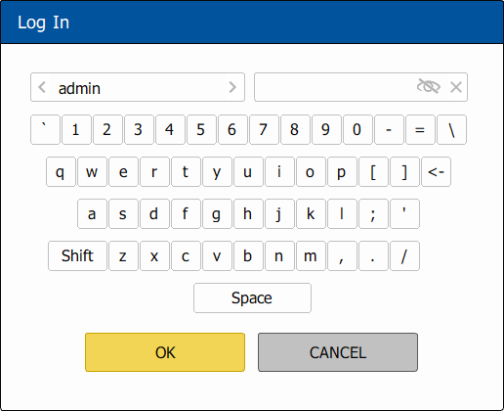
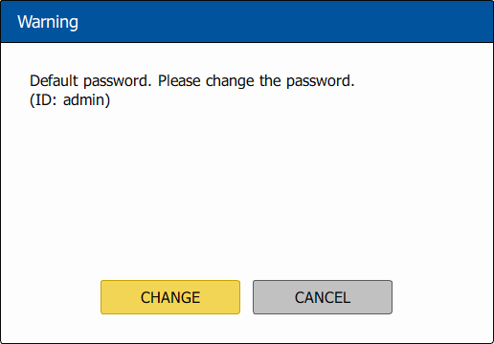
CH 3 How to Use
Password Protection – The DVR system will utilize a user ID and password system to prevent unauthorized usage of this product. Control of the system will only be possible after entering a proper ID and password as illustrated below. (Factory Default settings are blank for these fields).
IDs and passwords should be managed by a system administrator, as different users may be given different levels of access to the DVR.
If you do not change the initial password, the window below appears. For security purposes, please set the password in the user rights menu on the system.

Slide 20
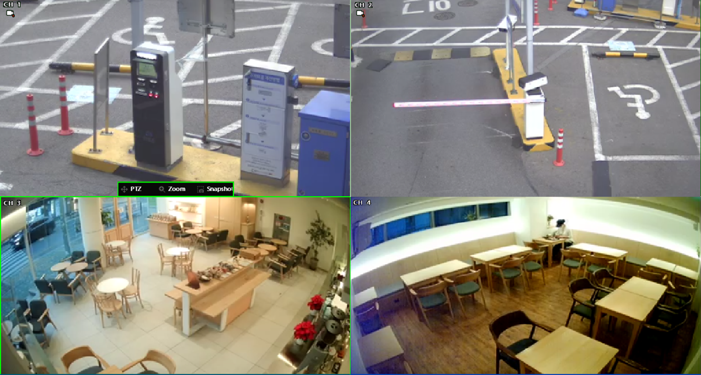
CH 3 How to Use
3-2. LIVE Mode
In this section you will know how to split the video mode into 1, 4, 6, 8, 9, 12, 16, as well as auto sequencing, PTZ Control, Mouse control, Setup configurations, Backup.
3-2-1. LIVE Mode Control
1) Live View Status
You may use the Live Menu Bar located at the bottom for quick shortcuts and view status of certain items.
 | Continuous recording indicator
 | Recording indicator
 | Motion detection indicator
 | Sensor activation indicator
 | POS in use indicator
2) Live Menu Bar
You may use the Live Menu Bar located at the bottom for quick shortcuts and view status of certain items.
If you choose a split mode with a blank area of the video, the live menu bar is changed as follows.

Slide 21
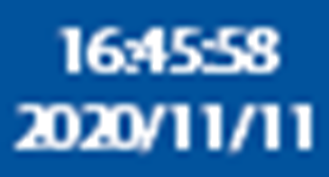
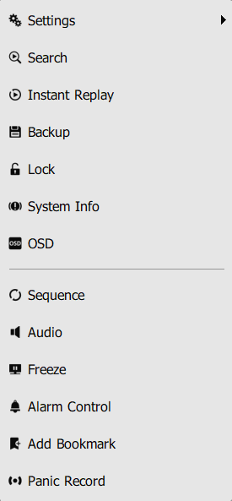
CH 3 How to Use
 | Go to settings
 | Go to playback
 | Screen Split mode change
 | Sequence activation
 | Audio out channel & Audio Mute indicator
 | Backup
 | Lock/ Unlock indicator
 | Hard drive usage & lamp
 | Scheduler activation indicator
 | Network connection indicator
 | Search Event List indicator
 | Date & Time
 | Live Menu Bar (Fix or auto hide)
3) Live Popup Menu
By Right-Clicking anywhere on Live mode, you may view the Live Popup Menu. By using the Live Popup Menu, you can quickly jump to the necessary configuration and settings.

Slide 22

CH 3 How to Use
4) Live Toolbar
When a channel is selected on live mode, the live toolbar is displayed as follows.
You can enter PTZ or Zoom mode or use Snapshot function.

Slide 23

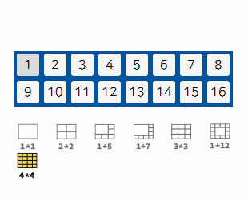

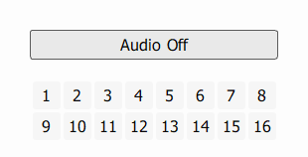
CH 3 How to Use
3-2-2. LIVE Mode Feature
1) Settings : refer to 3-4
2) Split
You can change video split mode for Live View. Click the channel number at the top to switch to the channel on the page.
3) Audio Out
You can choose the audio out from this menu.

Slide 24


CH 3 How to Use
4) Instant Replay
This is very convenient function to catch the abrupt accident. During live viewing, you can go directly to the playback screen.
If you choose the ‘Instant Replay’ it immediately switches to search mode and playback the video.
5) Search : refer to 3-3

Slide 25
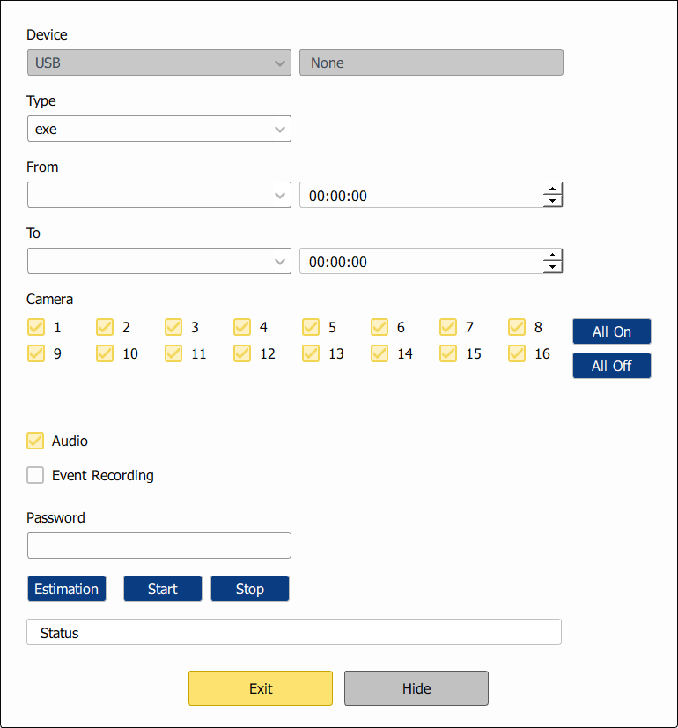
CH 3 How to Use
6) Backup
There are two ways to enter the backup. The first one is that right click on the live screen, and the second one is that enter directly from ‘Search’ upon playback. If you choose the ‘backup’ from the live menu, below backup screen appears.
You can set the backup device, time and channel from the backup screen.

Slide 26
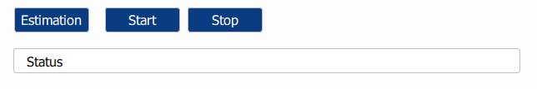
CH 3 How to Use
After that, if you push the ‘Estimation’ button, it will show the estimated backup file size.
Then click the ‘Start’ button.
WARNING
Do NOT remove the backup device till end sign. The device and system may be damaged.
7) Snapshot
You can save the live snapshot by this menu. All channel will be saved individually to the USB memory by JPG format . You should put in USB memory before saving.

Slide 27

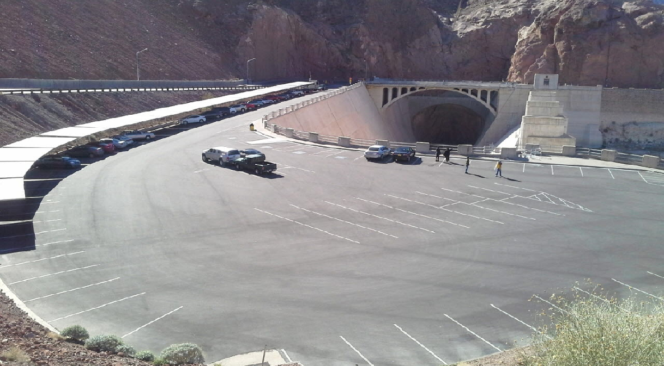













CH 3 How to Use
8) Freeze
You can freeze the current live video channels.
9) PTZ (Pan, Tilt and Zoom)
It is possible to control the pan and tilt camera by itself. Press the ‘PTZ’ button to enter the PTZ mode. For Menu setting, you can set it by pressing button as displayed at bottom of window.
You can set the direction of camera by using the arrow buttons.
Zoom
Focus
IRIS
Preset[SEL] | Preset setup
One Push[8] | Auto Focus
Menu[7] | Camera OSD menu
Zoom -/+ | Zoom out/in with mouse or [1]/[2] buttons on the remote controller.
Focus -/+ | Adjust the focus with mouse or [3]/[4] buttons on the remote controller.
IRIS -/+ | Adjust the iris with mouse or [5]/[6] buttons on the remote controller.
For more details, refer to [CH 2-2. Connection Using PTZ camera] and [CH 3-4-3. Device]

Slide 28
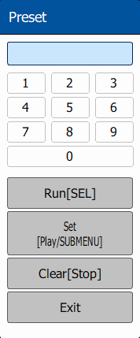
CH 3 How to Use
Preset(SEL) : You can enter the preset number using the keypad appearing the preset button or ‘Enter’ button on the remote controller.
Run[SEL] | Move to preset number
Set[Play] | Set a position and name of a preset number
Clear[Stop/Backup] | Clear a preset set
Exit | Exit preset mode
How to use Preset
Click the right mouse button and choose PTZ from a live pop-up menu.
After you move the screen, click the set button and set the position and name.
※ If you choose not a specified preset, UNDEFINED is displayed on the screen.
※ You can set up to 32. If you choose out of valid range, there is no action.

Slide 29
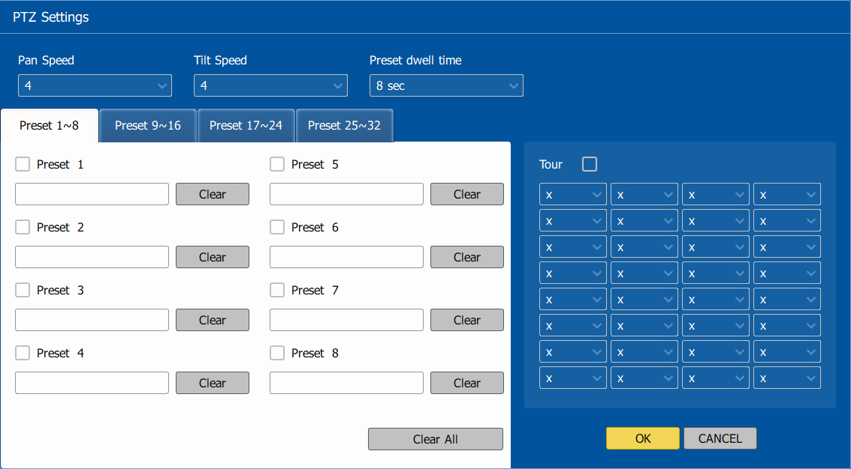
CH 3 How to Use
Camera[0] : You can choose the PTZ camera with mouse or [0] buttons on
the remote controller
Settings[9] : If you press Setup using mouse (or [9] button on the
remote controller) in PTZ Menu, PTZ setup window will
appear. You can set the pan and tilt speed, 32 preset name
and tour sequence as well as dwelling time.
Pan Speed | Set pan speed 1~7
Tilt Speed | Set tilt speed 1~7
Preset dwell time | Set preset dwell time 2~6 sec
Tour | When you check the tour box, the preset tour starts in the order specified by the user.
How to use Tour
Choose a preset from upper left to right.
※ If you use not specified presets, it automatically skip the tour.

Slide 30



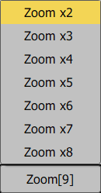
CH 3 How to Use
10) Zoom
Digital zoom of live screen for selected channel. It can be 8x zoom and also control the position by mouse dragging.
: You can choose the camera for zoom with mouse or [0]
buttons on the remote controller.
: You can zoom with mouse or [9] buttons on the remote
controller.

Slide 31
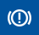
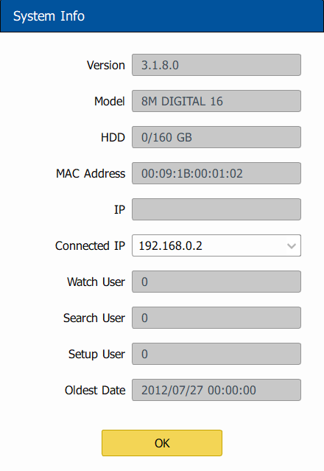
CH 3 How to Use
11) Sequence
Sequence Mode On /Off: Switches screens as set on Dwell time under Screen Setup
12) OSD
This feature shows current settings of product through GUI (Graphic User
Interface) and INFO button at front side is used for this feature. When you
turn on power, this will show current date and time, System Lock Setting, HDD
usage, Video Loss Check, Sensor ON/OFF, Motion Detection Check, Recording Status and Schedule Feature Usage. As you press INFO button once more, GUI
disappear->OSD disappear->GUI appear->OSD appear will happen sequentially.
GUI (Graphic User Interface): displaying current status on monitor as images
OSD (On Screen Display): displaying current status on monitor as character
CH 1 (x2)
13) System Information
It shows the system information.

Slide 32
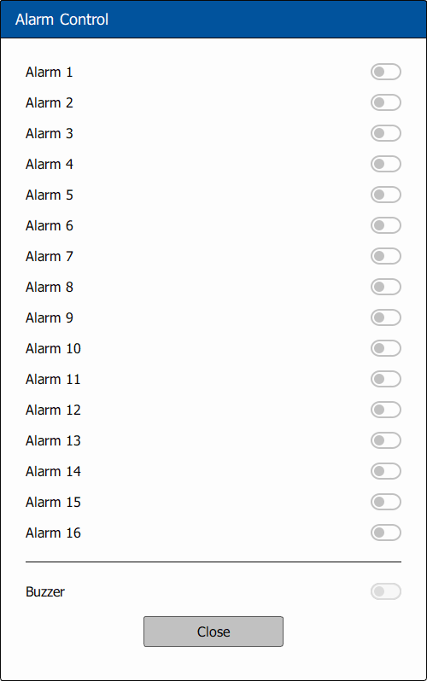
CH 3 How to Use
14) Lock/Log In
Logs off current user and locks DVR from any further configuration and screen setup until next Administrator logs in.
15) Alarm Control
You can control all alarms connected and the DVR system buzzer.
CH 1 (x2)

Slide 33
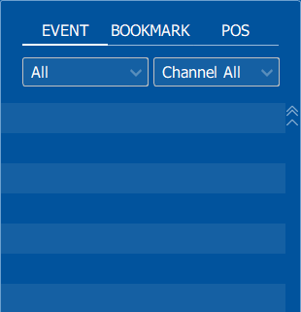
CH 3 How to Use
3-3. Search Mode
Search mode consists of two different modes of searching. The video data can be selected by 2 modes.
Time | Search by Month / Day / Time selection.
Panorama | Play a specific channel in the entire channel
Thumbnail | Play the specific channel by user defined interval.
In each mode, you can check the Event / Bookmark as follows, and it moves to the corresponding log time by double-click
The event types and channels that can be changed differ depending on the mode and combination of EVENT/BOOKMARK.
Search Mode | Event | Bookmark
Time | Both event type and channel can be changed. | Both event type and channel cannot be changed.
Panorama | Same as Thumbnail. | Same as Thumbnail.
Thumbnail | Only event type can be changed. | Both event type and channel cannot be changed.

Slide 34
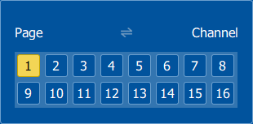
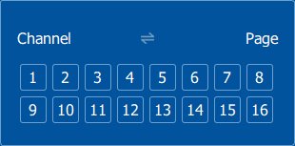

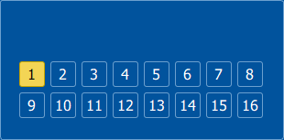
CH 3 How to Use
Change pages in time mode:
The page can be changed in two ways as follows.
(Page Mode)
(User Selection mode)
In the case of the page mode, it operates in the same way as the live view. User Selection mode is changed to 1 division of the corresponding channel when clicked. To switch between the two modes, click this icon.
Change channels in panorama/thumbnail mode:
The function changes by changing the target channel, not by changing the page. When clicked, the target channel is changed. The difference from User Selection in Time Mode is that User Selection in Time Mode also changes the split mode, but this function only changes the target channel and does not change the split mode.

Slide 35
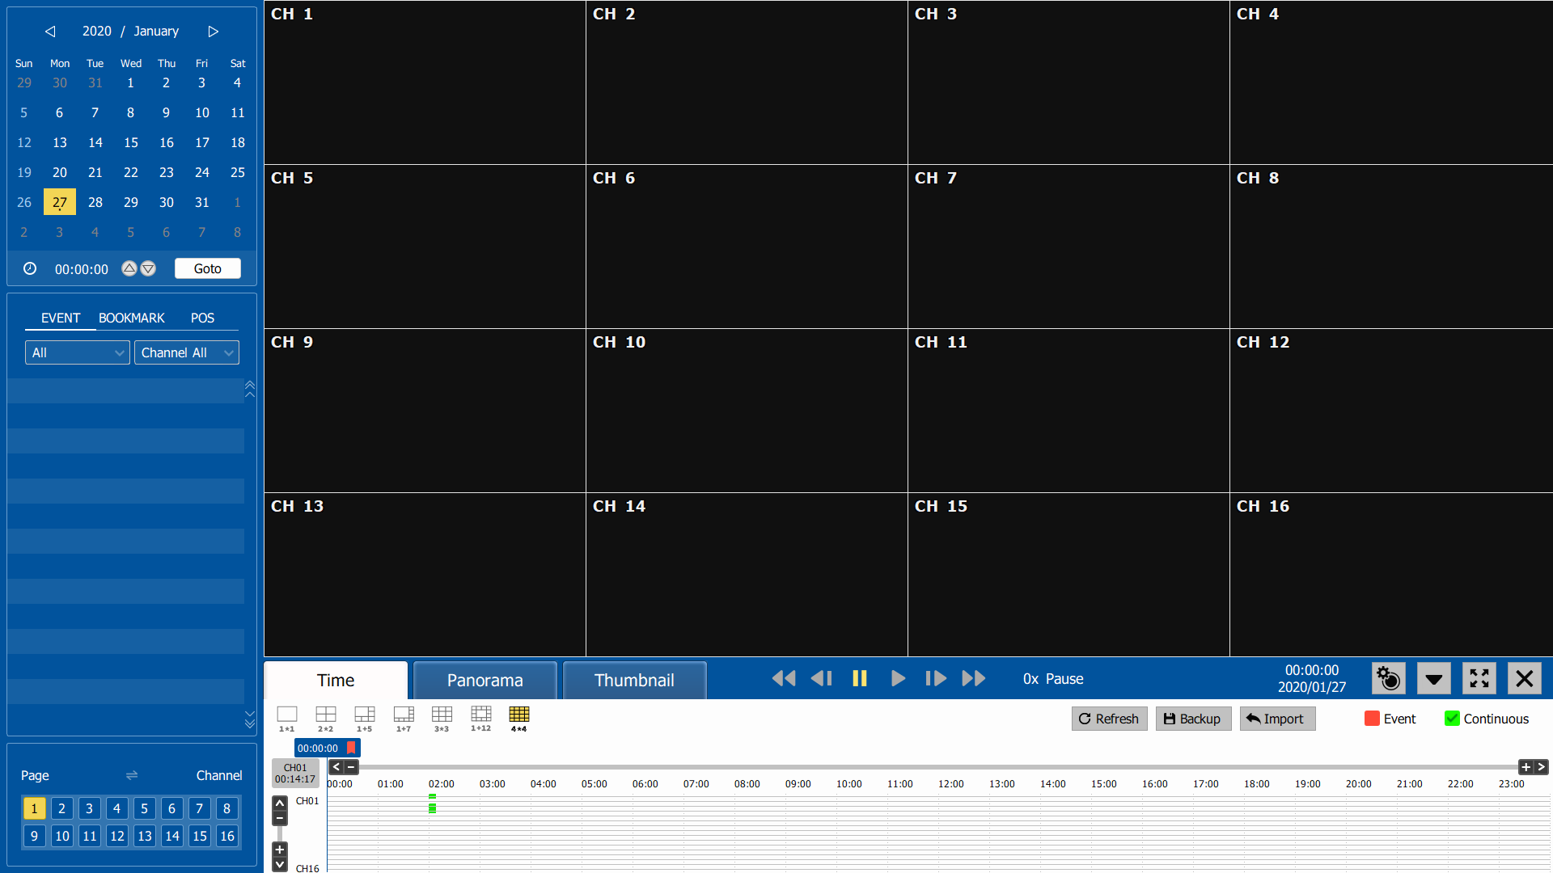
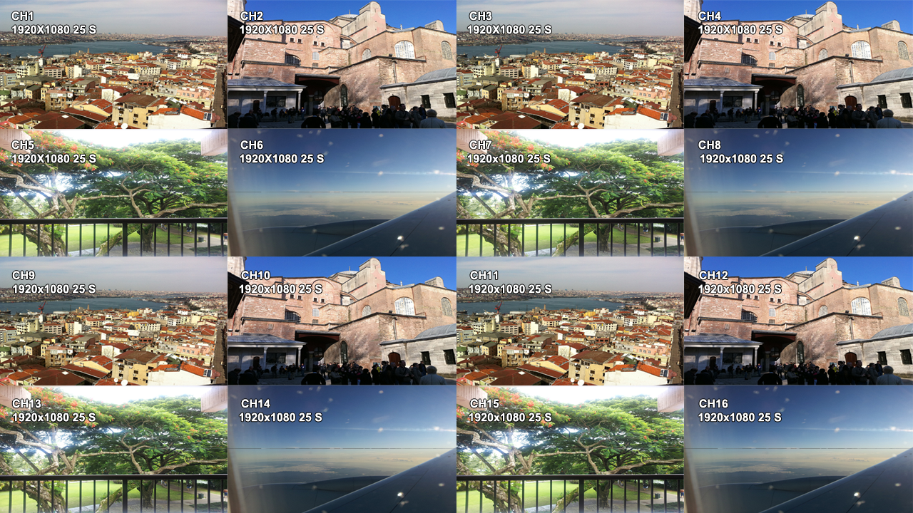
CH 3 How to Use
3-3-1. Search Selection Type
1) Time Based search selection
Select the Date you wish to view by selecting a Date from Calendar.
Select time you wish to view by selecting a time from Time Line.
You may click on Refresh, Backup, Import, Exit , Full Screen, Hide for additional features and options.

Slide 36
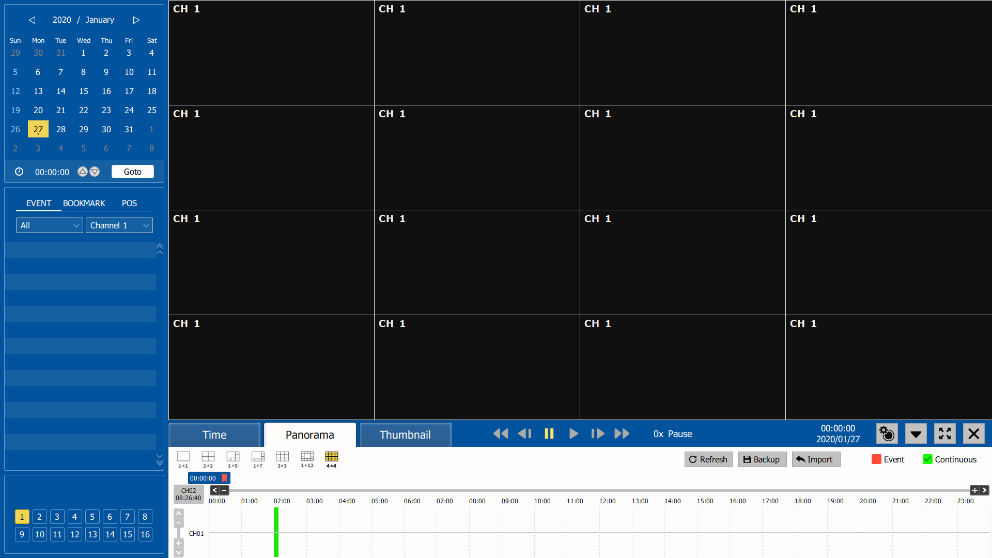
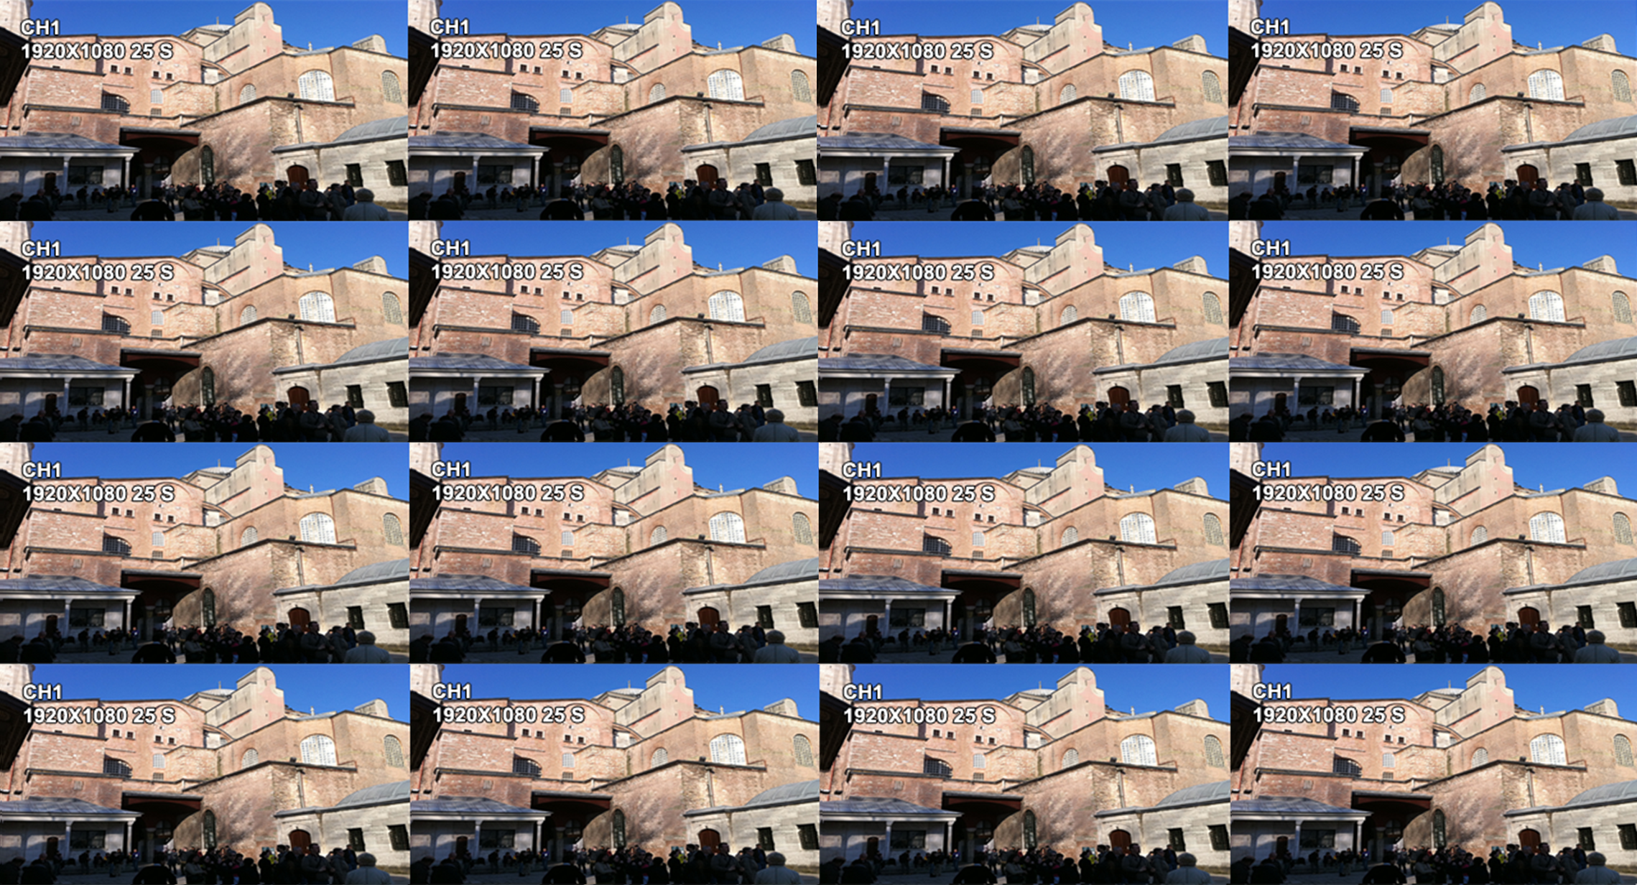
CH 3 How to Use
2) Panorama Search
Select search date from calendar
Choose the channel and time from bar or typing
The selected channel will be played continuously. If you want to play faster, use the FF button.

Slide 37
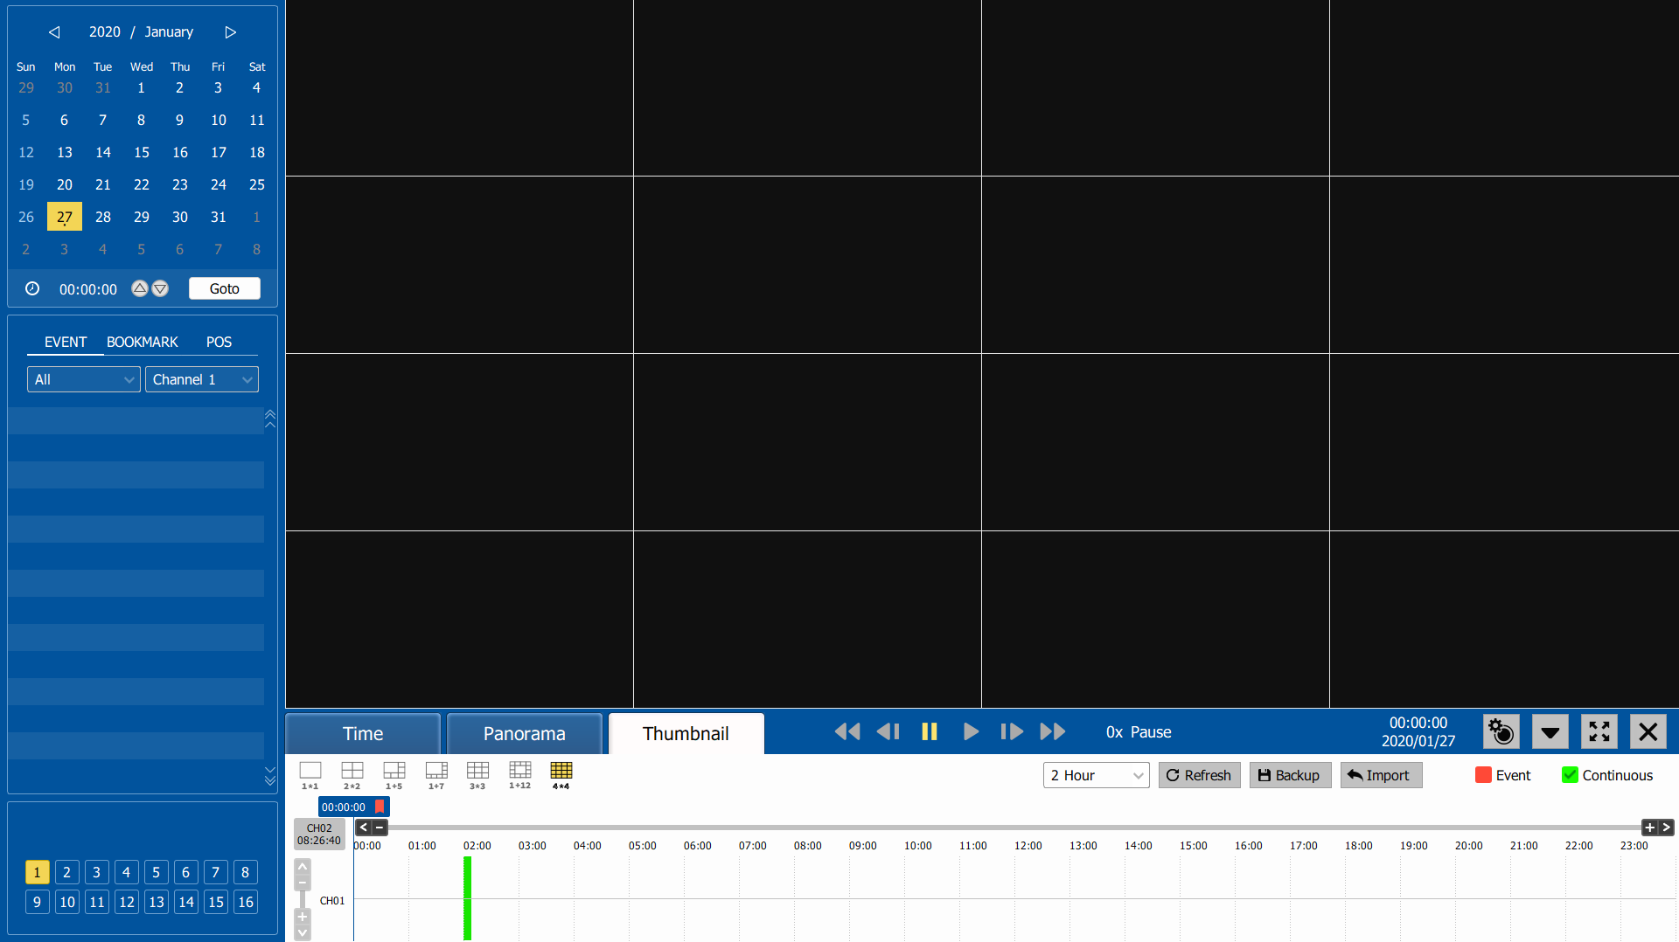
CH 3 How to Use
3) Thumbnail Search
Select search date from calendar
Choose the channel and time from bar or typing
The selected channel will be played continuously. If you want to play faster, use the FF button.

Slide 38



CH 3 How to Use
4) Search Related buttons
You may click on Refresh, Option, Backup, Import, Exit , Full Screen, Hide for additional features and options
 | Reload all data list.
 | Backup recorded data to external USB device.
 | Playback recorded data from external USB device.
 | Hide bottom of Playback Toolbar
 | Load playback data to full screen mode.
 | Move to Live video mode.
 | Event only
 | Search for continuous recording. If you want to see event recording, release the check.

Slide 39
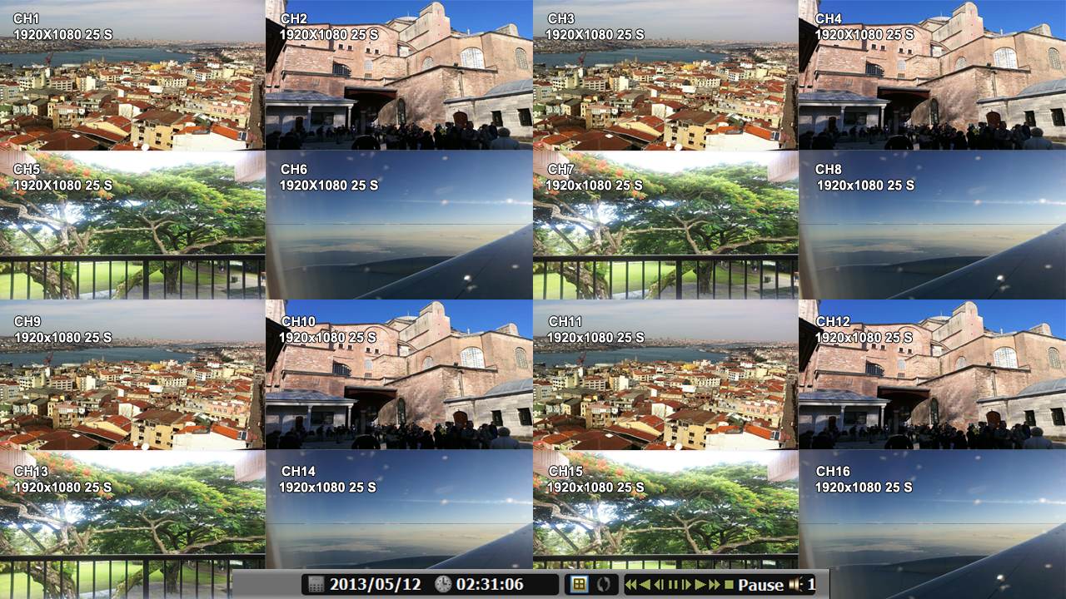
CH 3 How to Use
3-3-2. Play Mode
If you choose ‘Full Screen’, the full screen appear. You can control the play speed in here.
1 3 5 7 9 11 12 1314 16
2 4 6 8 10 15 17
▶ Play Screen GUI
1. Split Screen
2. Sequence
3. Audio
4. Event list
5. FB (Fast Backward): FB×1, 2, 4, 8, 16, 32, 64 times faster
6. SB (Slow Backward):SBx1/2, SBx1/4
7. STILL (Pause) / Frame advance
8. Play : Forward normal speed(×1)
9. SF (Slow Forward):SFx1/2, SFx1/4
10. FF (Fast Forward): FF×2, 4, 8, 16, 32, 64 times faster
11. Playback Status information
12. Date and time during playback : click to change date and time
13. Search option
14. Show: Timeline, Refresh, Backup, Import and Event Only
15. Cancel full screen
16. Exit Search mode
17. Toggle auto hide

Slide 40
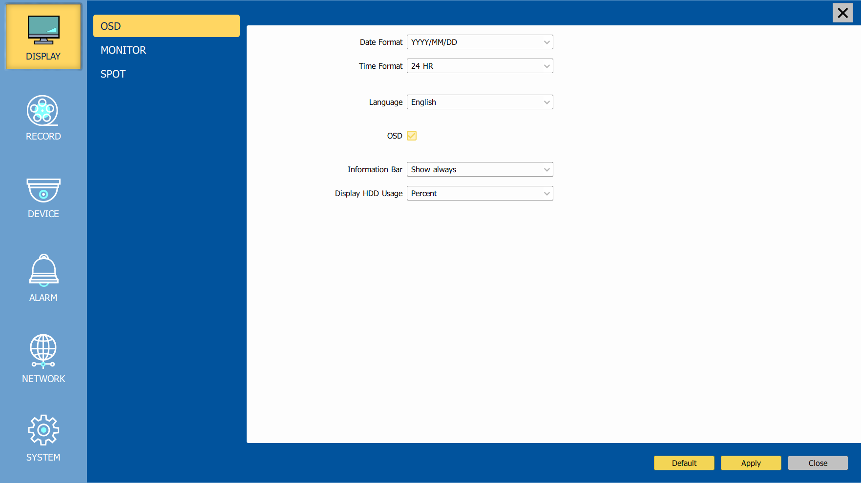
CH 3 How to Use
3-4. SETUP Mode
Access Setup menu from Right Clicking mouse button to Popup Menu.
Configure Display, Record, Device, Alarm, Network, System which is navigated by clicking on corresponding tab menu at the top of the screen.
Apply | Apply changes
Default | Return to factory default settings.
Close | Close the menu. If there is a something that has not been applied after the change, a pop-up will be asked.
3-4-1. Display
Configure OSD and Main Display setting.
1) OSD
Date Format | YYYY/MM/DD, MM/DD/YYYY, DD/MM/YYYY
Time Format | 24HR, 12H(AM/PM)
Language | Select system language.
OSD | OSD On/Off
Information Bar | Information Menu Bar Hide always/Auto hide/ Show always
Display HDD Usage | Percent/Oldest Date

Slide 41
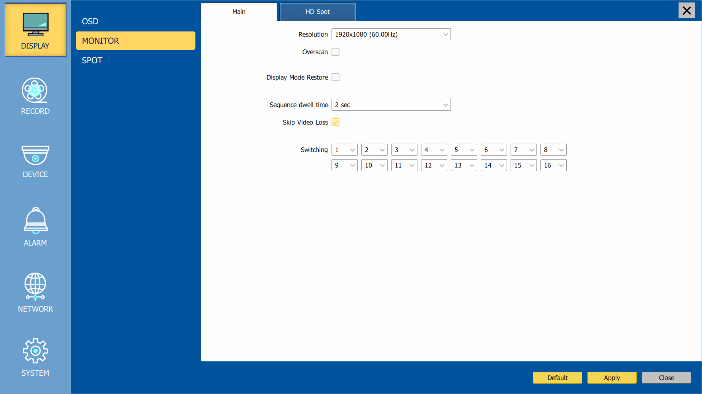
CH 3 How to Use
2) Monitor
Configure and view Resolution, Sequence Dwell Time settings.
Resolution | 1280x720, 1920x1080, 2560x1440, 3840x2160
Overscan | Cut off a bit of each edge of the screen
Display mode restore
Sequence dwell time | 1 sec ~ 60 sec
Skip Video Loss | Skip a video loss channel when you set the sequence of the live screen.
Switching | Set a display for the live screen.

Slide 42
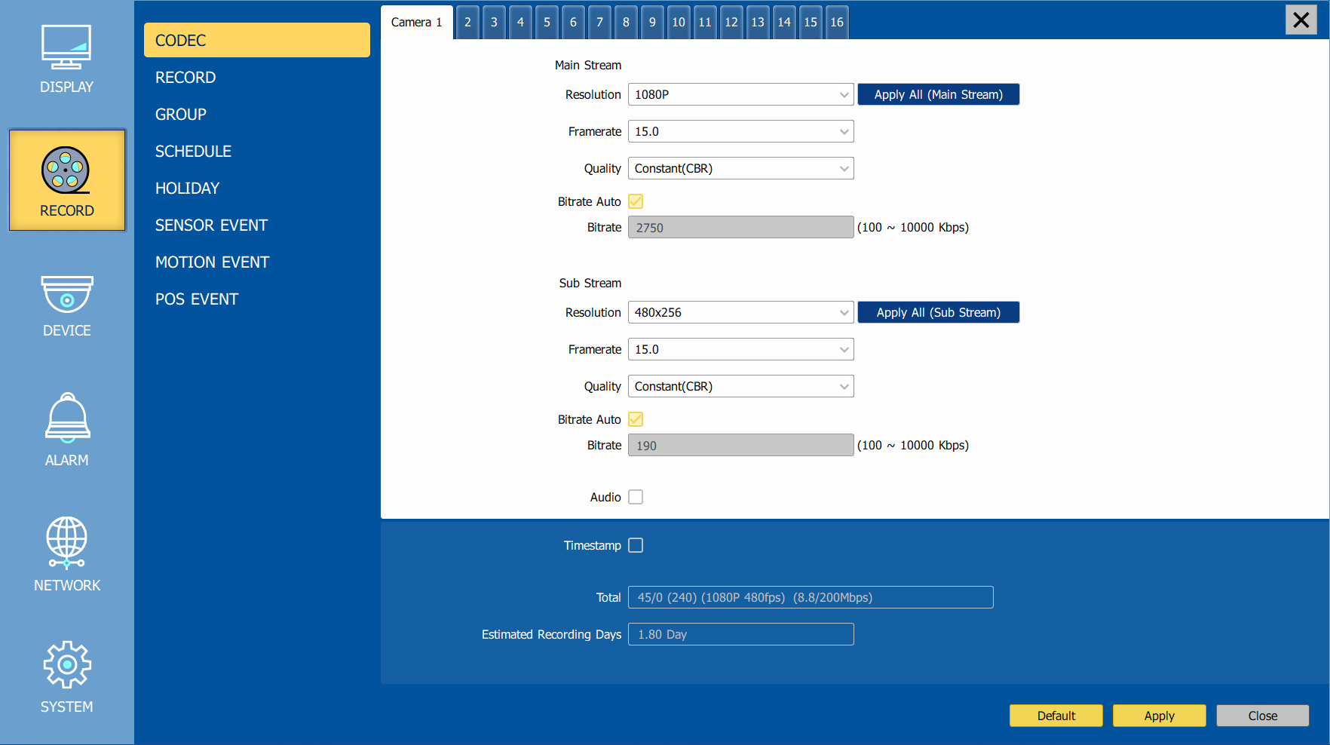
CH 3 How to Use
3-4-2. Record
Configure and view Event In, Record, Group, Holiday settings
1) Codec
Codec and Resolution | Set codec and resolution.
Framerate | Set Frame per seconds.
Quality | Set Quality.
ALL Apply | Apply the setting to whole channel.
Bitrate Auto | Automatically sets the best bitrate according to the camera resolution and fps.
Bitrate | Set the bitrate manually.
Audio | On / Off
Timestamp | You can check the ‘Timestamp’ to mark the time on recording files.
Total | It shows the total fps.
Estimated Recording Days | This is an automatic calculator of the recoding days.

Slide 43
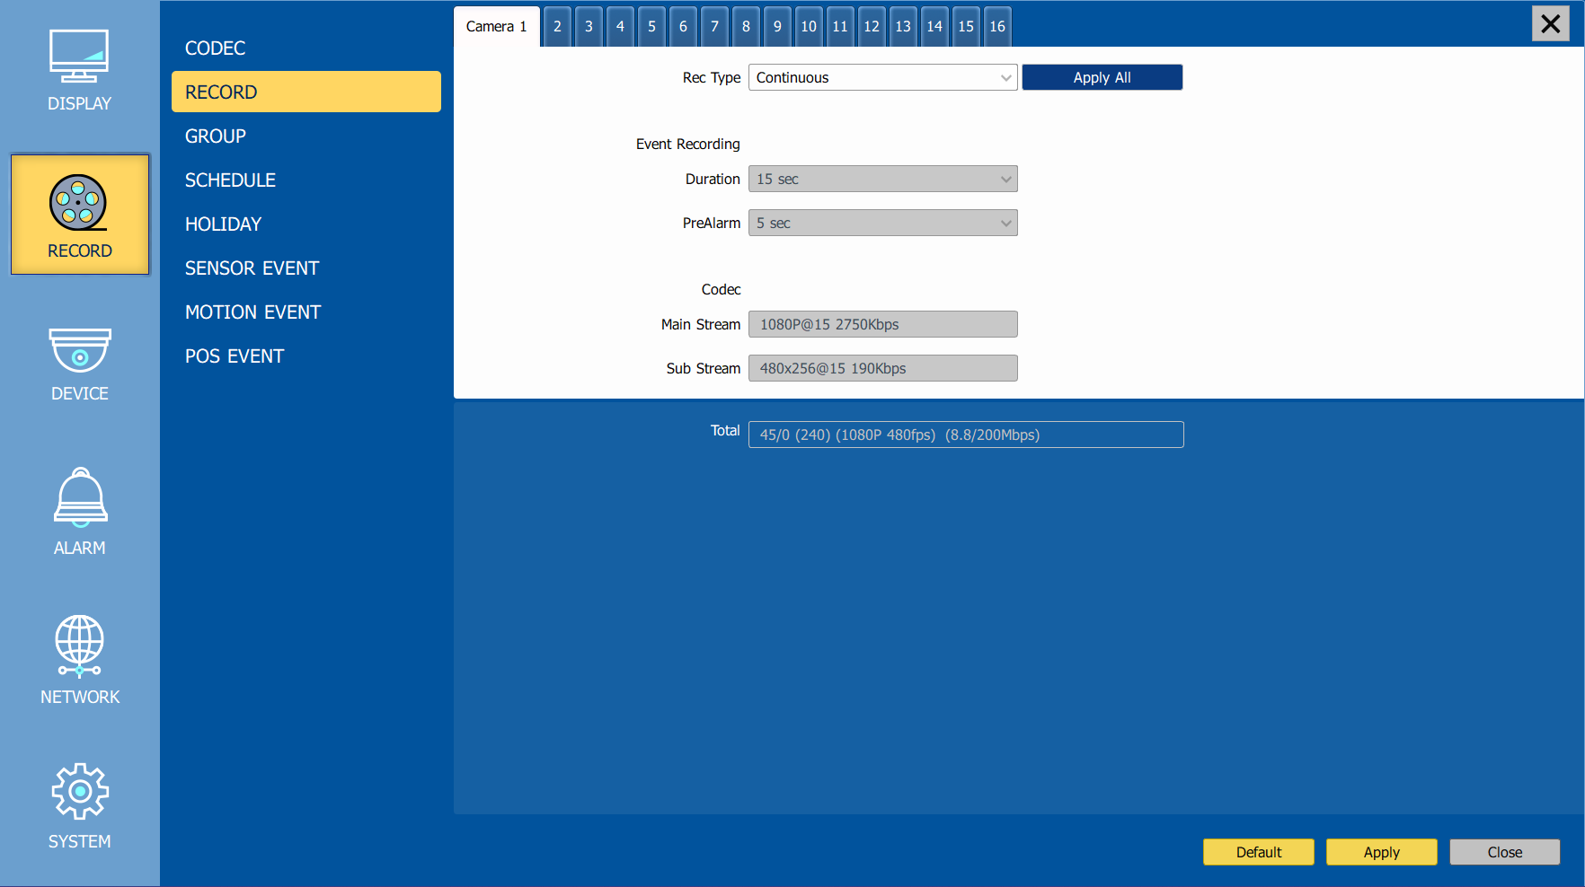
CH 3 How to Use
2) Record
Rec type |  | None, Conti, Event, C/E
Event | Duration | 5 ~ 60 sec
 | PreAlarm | 0 ~ 10 sec
ALL Apply |  | Apply the setting to whole channel.
Main Stream | The resolution of the main stream.
Sub Stream | The resolution of the sub stream.
Bitrate | It shows Bitrate of the camera.
Total | It shows the total fps / HDD transfer speed (Mbps).

Slide 44
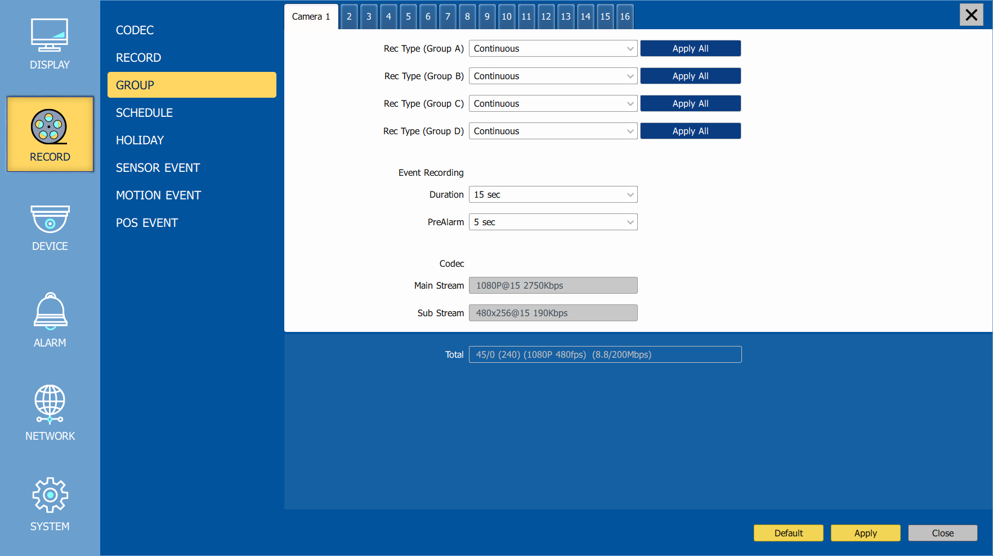
CH 3 How to Use
Event recording has priority in recording. In C/E recording, the recording will follow continuous recording setup in normal condition while it would follow event recording setup in event generation.
For convenience, you can use the ‘Apply All’ menu to change with the same preference. You don’t have to setup each channel if you using the ‘Apply All’ function.
Duration is to set post event recording time.
Pre alarm is to set pre event recording time.
Total shows total fps of all channels. If total fps is more than supported, it turns red. If it turns red, you need to set a lower resolution or FPS.
Event recording has priority in recording. In C/E recording, the recording will follow continuous recording setup in normal condition while it would follow event recording setup in event generation.
3) Group
With this menu, you can set the group using the scheduler. If you choose ‘Group’ tab, you can see the similar screen with ‘Record’. The setting is similar

Slide 45
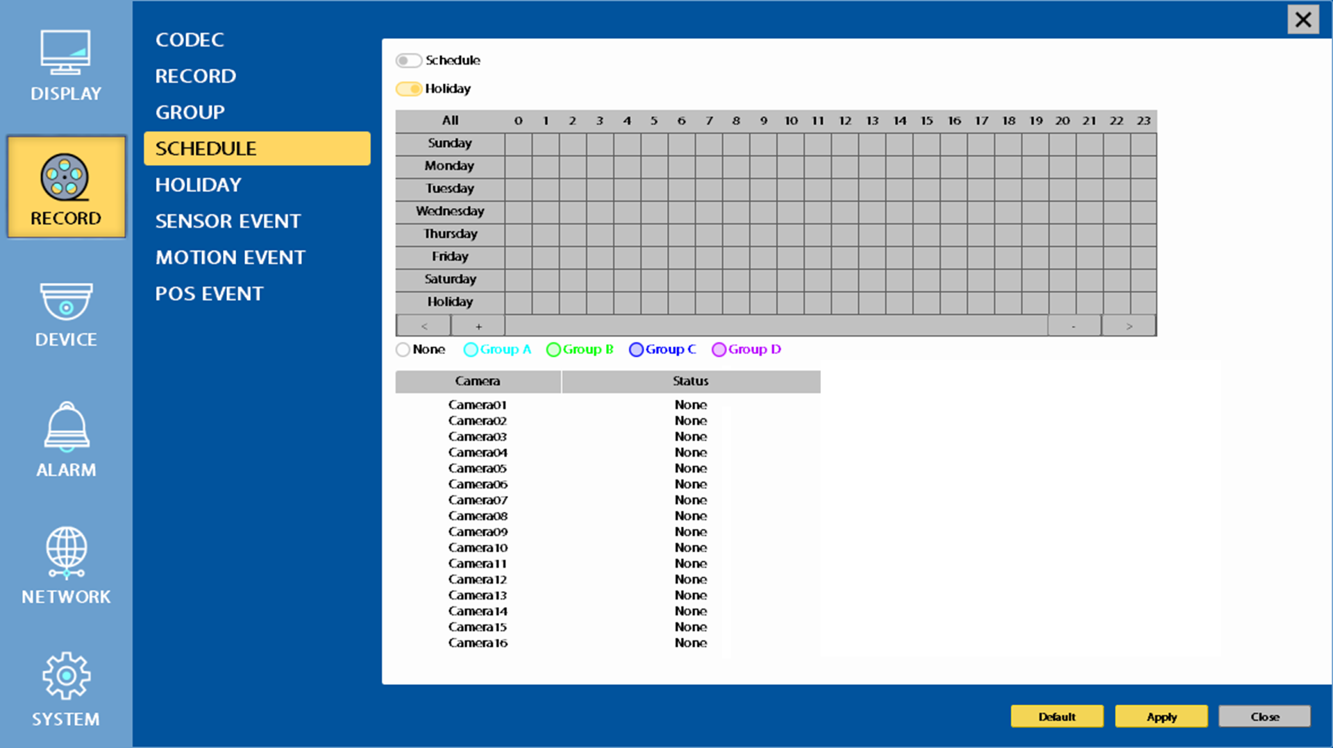
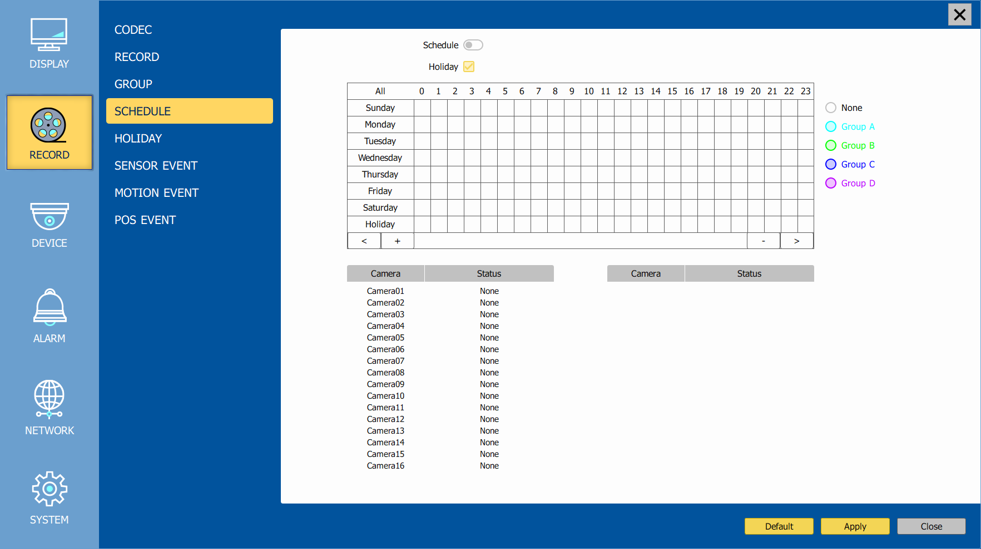
CH 3 How to Use
CH 3 How to Use
4) Schedule
In recording, Schedule recording setting is most preferred. So if you activate the weekly scheduler, you cannot record manually.
Schedule On : The weekly scheduler is activated.
Holiday On : The holiday that set by user is activated.
Since you can set recording weekly, you can reduce recording of unnecessary time period. In Scheduler window, days and channels are displayed, and recording information for each channel is displayed at bottom of window.
How to set the weekly scheduler
1. Choose 'Scheduler' to 'On'.
2. Choose group and drag to wanted time.
3. Press the time bar , if you want to set the detailed time.
4. Press ‘Enter' button to change the group of the selected area.
5. If you activate ‘Holiday’ scheduler, choose ‘holiday’.

Slide 46
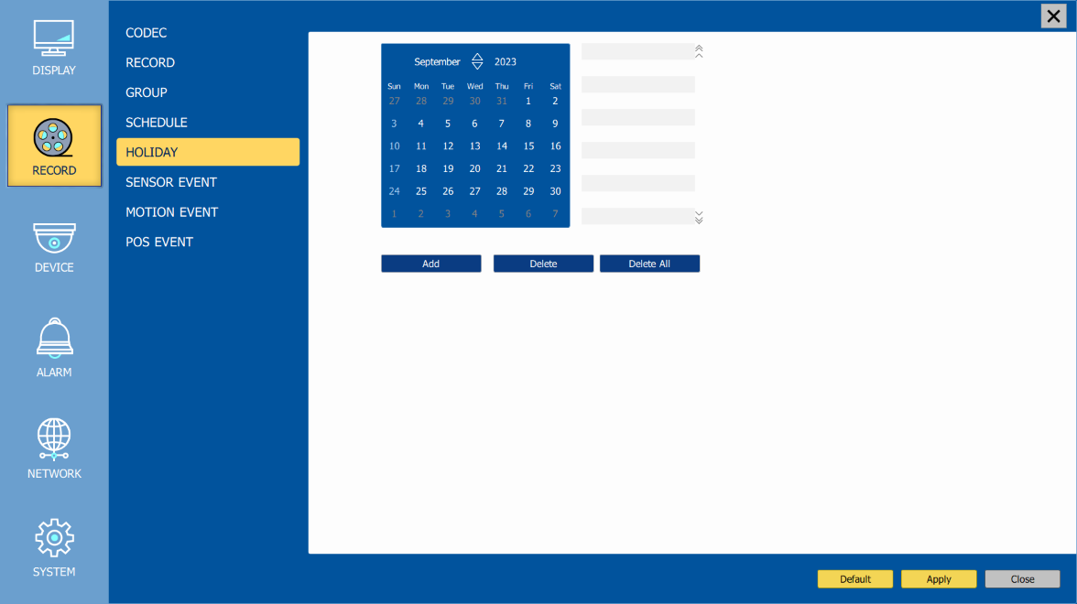
CH 3 How to Use
5) Holiday
With this menu, you can add the holidays. Use the ‘Add’ button for adding the holiday and use the ‘Delete’ or ‘Delete All’ buttons for removing the existing holidays.

Slide 47
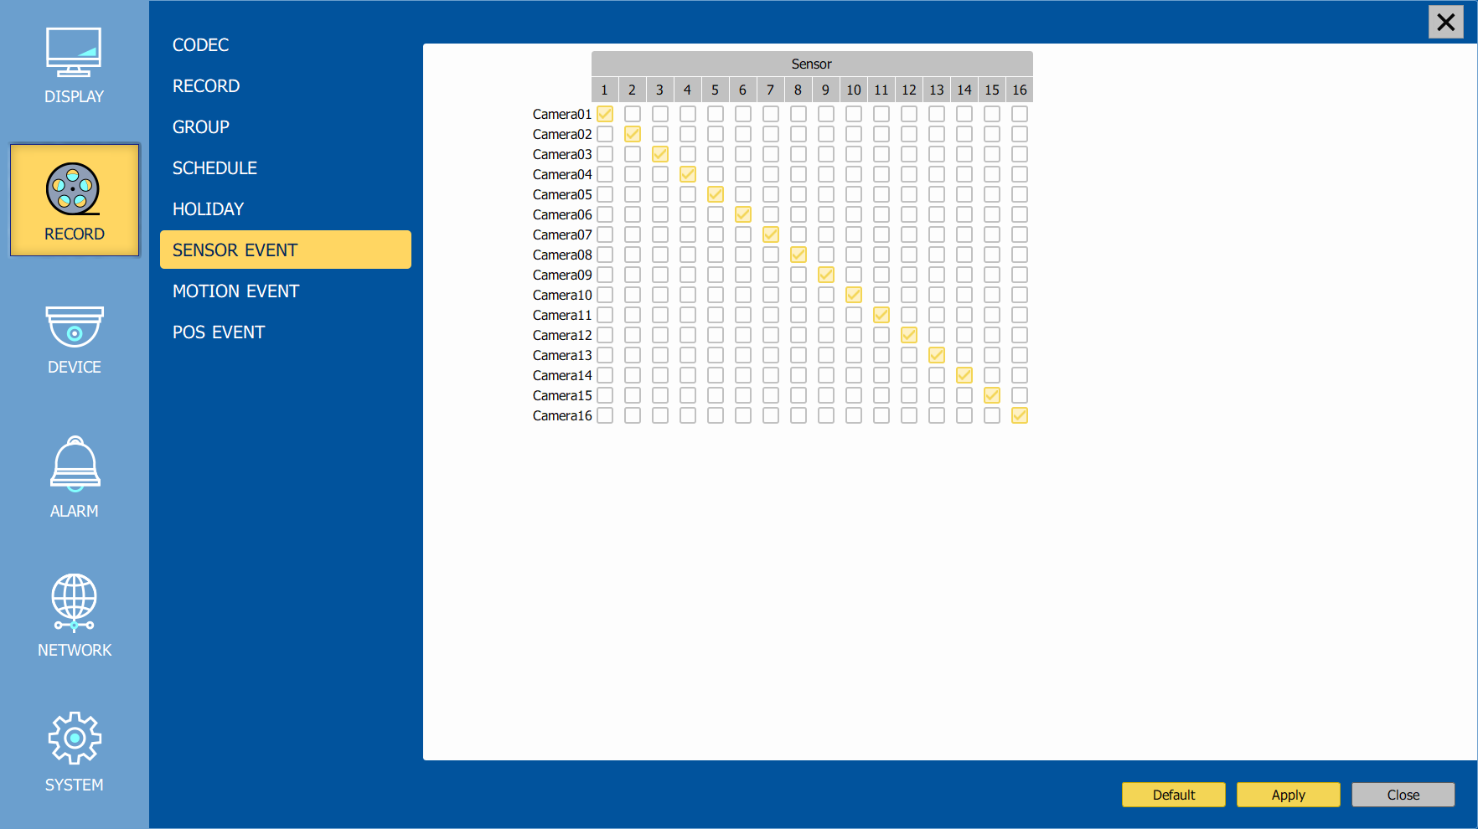
CH 3 How to Use
6) Sensor Event
With this menu, you can set sensor input setup. You can also set each channel individually.
Although you set Motion Detection and Sensor Setting to On in Event menu, if Event Input in Rec Menu is set to None, it only detects and does not record.

Slide 48
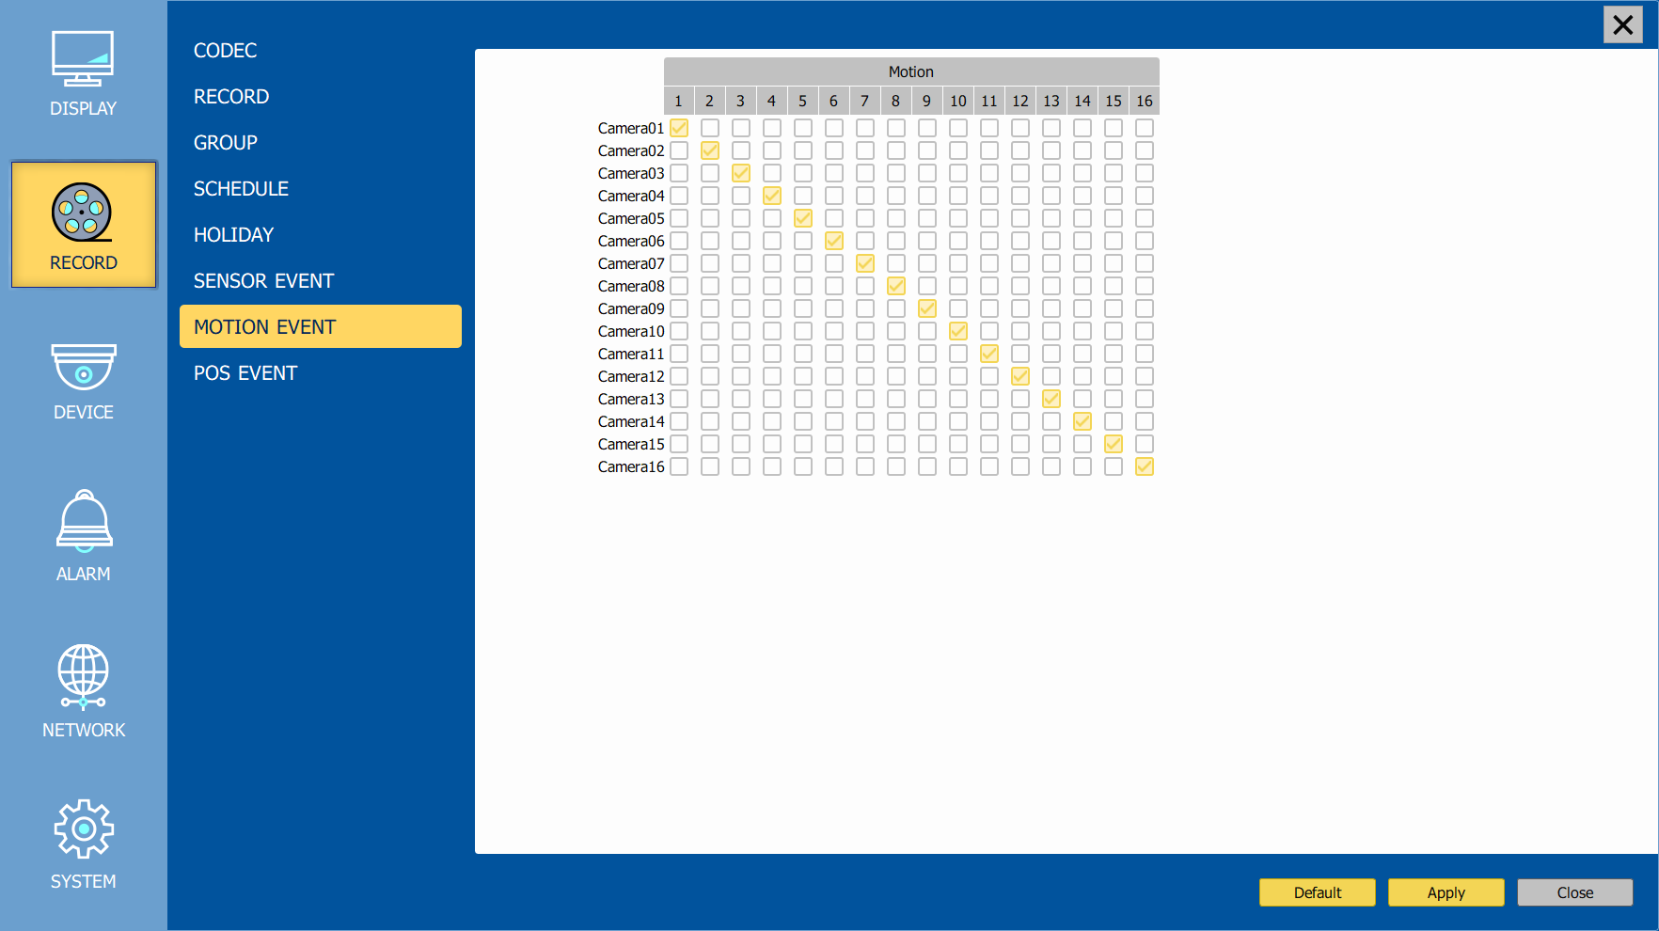
CH 3 How to Use
CH 3 How to Use
7) Motion Event
With this menu, you can set motion detection setup. You can also set each channel individually.
Although you set Motion Detection and Sensor Setting to On in Event menu, if Event Input in Rec Menu is set to None, it only detects and does not record.

Slide 49
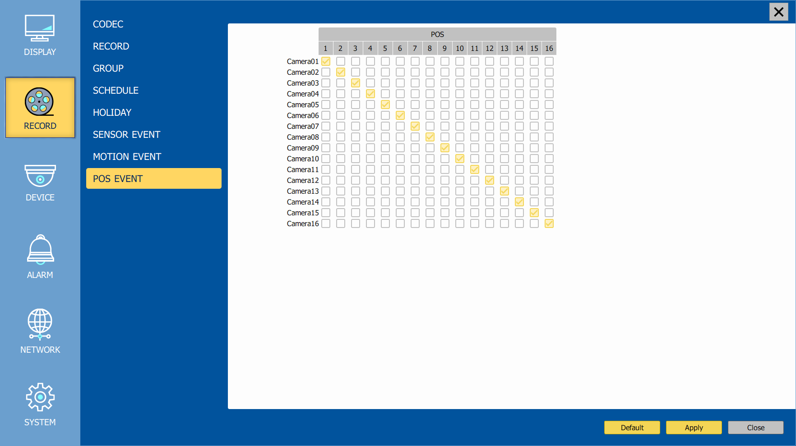
CH 3 How to Use
8) POS Event
With this menu, you can set POS setup. You can also set each channel individually.
Although you set Motion Detection and Sensor Setting to On in Event menu, if Event Input in Rec Menu is set to None, it only detects and does not record.

Slide 50
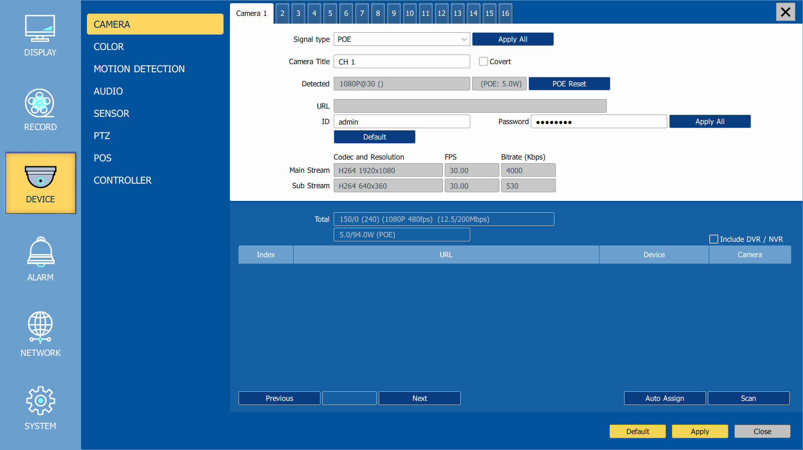
CH 3 How to Use
3-4-3. Device
Configure and view Camera, Audio, Motion Detection, Alarm Out, PTZ, Controller.
Camera
Signal Type | On / Off POE or set to IP camera
Apply All | Apply the setting to whole channel.
Camera Title | You can set a camera name.
Covert | Hide a camera from Live view but Record for future searching option.
Detected | Detected a camera video type
POE Reset
URL | Type IP Camera address or use Scan function
ID/Password | Type ID and password of the camera
Apply All | Apply the setting to whole channel.
Main Stream/Sub Stream | It shows the main and sub stream of the camera.
ALL Apply | Apply the setting to whole channel.
Default | Clear assigned camera settings.

Slide 51

CH 3 How to Use
For convenience, you can use the ‘Scan’ function to connect all your IP cameras on your network or NVR.
Include DVR / NVR | Whether to add a DVR / NVR camera
Previous | Go to previous page
Next | Go to next page
Auto Assign | Auto assign IP cameras on the list to each channel.
Scan | Scan IP cameras

Slide 52


CH 3 How to Use
2) Color
Brightness | Adjust Brightness
Contrast | Adjust Contrast
Saturation | Adjust Saturation
Hue | Adjust Hue
Sharpness | Adjust Sharpness
Default | Change to default settings
ALL Apply | Apply the setting to whole channel.

Slide 53


CH 3 How to Use
3) Motion Detection
Change settings for Motion Grid selection and Sensitivity Level. You can set multiple area.
Sensitivity | Low, Mid, High
All On | This will activate the motion detection of the all area.
All Off | This will deactivate the motion detection of the all area.
Apply All | Apply the setting to whole channel

Slide 54

CH 3 How to Use
4) Private Zone
If you want to hide some part of the picture for privacy, you can choose the area by dragging the mouse. The selected area will be changed to black screen.
All Off | All off the private zone
Apply All | Apply the setting to whole channel

Slide 55

CH 3 How to Use
5) Audio
Camera | Assign audio input to a video channel.
Audio Out 1 | Select which channel will be heard during Live View with HDMI.
Audio Out 2, 3, 4 | Select which channel will be heard during Live View.

Slide 56

CH 3 How to Use
6) Sensor
Selectable option is N.O. (Normally Open) / N.C. (Normally Close)
For more details, refer to [CH 2. Installation Method and Cautions].(p.17)

Slide 57


CH 3 How to Use
7) PTZ
Configure Pan/Tilt/Zoom camera for control via DVR System and Remote client.
Driver | Choose Driver to be suitable for PAN/TILT Camera manufacturer.
Address | Choose address to be suitable for PAN/TILT Camera manufacturer.
Baudrate | Choose baudrate to be suitable for PAN/TILT Camera manufacturer.
You have to set Comport value according to the connected camera.
For connection of PAN/TILT Camera Receiver part, refer to user's manual of the related PAN/TILT Camera.

Slide 58

CH 3 How to Use
8) POS
This sets the POS interface(text inserter) with the DVR and cash register.
※ If you are using a USB hub, you can use up to 4 USB POS.
Channel | Select a Channel of POS
Baudrate | Select a baudrate of POS
Databit | Select a databit of POS
Start Word | Type a start word of transaction
End Word | Type a end word of transaction. Text will be embedded into the picture between start word and end word.
Ignore Word | Type a word which you want ignore during text insertion.
Skip Text | Skip String range.
Number of add line | This will determine the adding line after end word. (0~4)
Overlay Position | This will determine the text position.
Text Overlaying Duration | This will determine how long display the text up to 120 seconds. (60~120 sec)
Text Size | Change text size.
Text Color | Change text color.

Slide 59





CH 3 How to Use
How to Connect POS
1. Connect USB to RS232 serial cable between POS and DVR.
USB
USB
*POS *DVR
2. To set manually, at first you should know the setting values of the POS. You can get the information from the POS setting screen.
3. If your setting is correct, you can see the below DVR screen on transaction. (This is the popup screen. You can set popup in the ‘Event In’ setup.)

Slide 60

CH 3 How to Use
9) Controller
This sets the ID of remote control. If you have many DVRs in the same place, you can control separately the DVR by different remote control ID.
Remote controller ID setup
Use the ID setup and number key to set the ID of remote control on the remote controller. You may check the ID by pressing the remote control key. The ID should be the same between the DVR and remote control.
And you can turn it on/off the key sound.
Remote Controller ID | All, 00 ~99
Key Buzzer | ON / OFF

Slide 61

CH 3 How to Use
3-4-4. Alarm
4-1) Sensor In
You can choose the action after sensor in between relay, buzzer sound and pop up. Also you can choose more than one action.
Choose a sensor connected to a channel.
If a sensor does not work, please check again the sensor type.

Slide 62

CH 3 How to Use
Also you can choose more than one action. Furthermore you can set the preset position number by motion detection. If you click the ‘setup’ icon you can see the preset screen.
You can assign the preset position individually by specific motion.

Slide 63

CH 3 How to Use
4-2) Motion Detection
You can choose the action after motion detection between relay, buzzer sound and pop up.

Slide 64

CH 3 How to Use
Also you can choose more than one action. Furthermore you can set the preset position number by motion detection. If you click the ‘setup’ icon you can see the preset screen.
You can assign the preset position individually by specific motion.

Slide 65

CH 3 How to Use
4-3) Motion Detection + Sensor In
You can choose the action after motion and sensor detection between relay, buzzer sound and pop up.

Slide 66

CH 3 How to Use
Also you can choose more than one action. Furthermore you can set the preset position number by motion detection. If you click the ‘setup’ icon you can see the preset screen.
You can assign the preset position individually by specific motion.

Slide 67

CH 3 How to Use
4-4) Video Loss
You can choose the action after video loss between relay, buzzer sound, and pop up.
Also you can choose more than one action.

Slide 68

CH 3 How to Use
4-5) POS
You can choose the action after POS transaction or video loss between relay, buzzer sound and pop up.
Also you can choose more than one action.

Slide 69

CH 3 How to Use
4-6) Snapshot
Set up snapshot according to the set email settings

Slide 70

CH 3 How to Use
4-7) HDD
Set an alarm or buzzer when S.M.A.R.T error occurs in the HDD

Slide 71


CH 3 How to Use
4-8) Alarm
You can choose the duration time from 5 to 60 seconds after motion detection between relay, buzzer sound, pop up and preset.
You can set a name of the alarms.
Email
Set events to send the email.
Interval | Set an interval for sending emails.
Add Image | Send a snapshot of events to the email.
Schedule | Set schedule.

Slide 72

CH 3 How to Use
3-4-5. NETWORK
Configure and view Address, Port, DDNS, E-mail, Control and Status settings.
1) Address
Configure Network information for Remote client connection.
NVR Name | Type the URL of NVR using virtual keyboard.
MAC Address | Display the MAC address of the NVR
DHCP
Auto IP | Assign IP automatically or manually enter IP, subnet mask, gateway
IP | Type the IP address.
Subnet Mask | Type the subnet mask.
Gateway | Type a gateway.
DNS Auto | If you connect LAN after setting it to On, DNS IP is allocated automatically. If you set it to Off, you have to input DNS IP.
DNS IP | Type the DNS IP.
PING Test | Run the ping test with the currently set DNS IP
Status | Ping Test Results Display

Slide 73

CH 3 How to Use
2) Port
There are 4 kinds of ports for the case such as watch, search, setup and web. You can individually set the port number of the DVR. The default is 8000. You can choose from 8000 to 9999.
If you activate ‘uPNP (Universal plug and play)’ box, DVR connects the router automatically with these port number. You don’t have to setup the router.
Watch | Type the port. (1000~40000)
Search | Type the port. (1000~40000)
Setup | Type the port. (1000~40000)
Web(Onvif) | Type the port. (80, 1000~40000)
RTSP | Type the port. (554, 1000~40000)
uPNP | ON / OFF
uPNP Test | Test uPNP
Status | It shows the test result of uPNP.

Slide 74

CH 3 How to Use
3) DDNS
This is the function to automatically change the IP of DVR to URL. This product supports the automatic DDNS service using manufacture’s internal server. Also you can choose Dyndns.
DDNS Type | Choose a DDNS type.
DDNS Server | Defend on the DDNS type, it will be auto-typed or disable.
Domain name | Type the port of the email account.
ID | Defend on the DDNS type, it will be auto-typed or type the ID of your DDNS.
DDNS Password | Type the DDNS password.
Duration | Choose the time sync frequency with DDNS server.
DDNS Test | Test your DDNS.
Status | Success/Failure Indication on DDNS Server Connection

Slide 75

CH 3 How to Use
4) Magic IP
P2P service, which enables network access simply by using a smartphone to scan the supplied product QR code.
Magic IP setup
Check Magic IP.
Make your own ID for Magic IP.
The ID must start with letter and contain at least 8 characters.
When the test is done and succeed, it’s QR code is automatically created.

Slide 76

CH 3 How to Use
5) E-mail
You can send a notification of events by email. Fill all the information correctly and push the ‘Email Test’. Also you can select each event individually by ‘Event Set’.
Recipient | Type the email address of the recipient.
Sender | Type the name of the sender.
SMTP Server | Type the SMTP server of the email account.
Port | Type the port of the email account.
Authentication | Set whether you want to use authentication or not (On/Off).
SSL/TLS | Set whether you want to use SSL/TLS or not (On/Off).
Account | Type the email account of the sender.
Password | Type the password of the send’s email account.
E-mail Test | Test the email account.

Slide 77

CH 3 How to Use
3-4-6. SYSTEM
Configure and view system Date/Time, User Authority, Storage, System Log and Configuration settings
1) Date/Time
Timezone | Choose the time zone of your site. If you using the NTP function, it must be set correctly to your zone.
Daylight Saving Time | It enables to adapt the day light saving time automatically.
Date / Time | This sets product time. Input time by pressing number buttons after moving cursor with direction buttons. Be careful to move to backward. The overlapped data will be deleted with warning message.
NTP (Network Time Protocol) Server | This function is to change the time of DVR automatically via network. Press the ‘Enter’ button and using the virtual keyboard, type the address of NTP server.
NTP Check | choose the time sync frequency.
Sync | Sync the time and NTP.

Slide 78

CH 3 How to Use
2) Account
This sets User authority individually. You can give to each users the authorities such as setup, search, backup, PTZ, network and camera control.
ID | Type an ID.
Change Password | Type a password.
Settings | Authorizes the setting of the system.
Date/Time | Authorizing date/time permissions for the system
Search | Authorizing the search of the system.
Backup | Authorizing backup of the system.
PTZ | Authorizing PTZ of the system.
Network | Authorizing network of the system.
Lock | Select the auto-lock time.(Off, 1~10 min)
Password Change Cycle | Select the password change cycle.(Never, 1~3 months)
Network Event Notification | Authorizing a network event notification.
Camera | Authorizing a camera.

Slide 79

CH 3 How to Use
3) HDD
Display the information and usage of the hard disk drives.
Total | Display the HDD usage being used for the product. If you press the ‘Format’ button on here, all the hard disk drives will be formatted.
HDD Check | Check the HDD.
HDD Overwrite | Determine whether you want to continue recording if there is no spare saving space at hard disk drives.
Disk Mirroring | Set disk mirroring (with 2 HDDs)
Auto Deletion | You can select the holding period of the data. If you choose ‘OFF’, the DVR keep the maximum data regarding the HDD capacity.

Slide 80

CH 3 How to Use
4) S.M.A.R.T :Self-Monitoring Analysis and Reporting Technology
This function lets you probe the hard disk drives and investigate the status of the drivers automatically.
S.M.A.R.T.
S.M.A.R.T. On | Set whether you want to use S.M.A.R.T. or not (On/Off).
Check Day | Determine the date to perform the S.M.A.R.T.
Boot Message | The number of message of showing the errors.
Temperature
Check Time | Temperature check period.
Limit | The upper tolerance of the hard disk drive temperature.
HDD Status | Replace the hard disk if the error/test contains an error number or if there is an increase in the number in the relocation (sector).

Slide 81

CH 3 How to Use
5) System Log
You may view all System administration log from Setup → System → System Log. Also you can export the system log and easily send it to technical support for trouble shooting.
Refresh | Refresh the system log.
Export | Export the system log.

Slide 82

CH 3 How to Use
6) Auto Reboot
Set schedule for auto reboot.
Auto Reboot | On / Off
Every Day | Check to reboot daily
Period | Set auto reboot period
Day Of Week | Set the day
Time | Set the time

Slide 83

CH 3 How to Use
7) Configuration
Shown at the following screen, from Setup → System → Firmware, you may view the current firmware version as well as Upgrade the firmware and additionally, Export, Import, and Default DVR Configuration.
Firmware version | Show the firmware version.
Upgrade | Upgrade the firmware.
Export | Export system settings.
Import | Import system settings.
Keep Network Settings | Preserve network settings when you run settings defaulted.
Default | Return to factory default settings.
System Restart | Restart the system.
System Shutdown | Power off the system.
You should connect correctly the USB devices, before you use firmware upgrade, export and import.

Slide 84


CH 3 How to Use
3-5. Firmware Upgrade
If you want to upgrade, please follow that;
Download the latest firmware to USB memory root directory.
Put this memory to USB slot of DVR.
Choose ‘Upgrade’ and you can see the below screen will appear.
Select the desired file, then choose ‘OK’.

Slide 85




CH 3 How to Use
If you choose OK, you can see the below download window on the DVR screen.
☞ WARNING!!!
Do not turn off the power during download procedure. If you power off manually, all memory will be deleted !
※ After upgrading, DVR will reboot automatically. Before rebooting, do not
operate manually !

Slide 86
Trouble Shooting
Trouble Shooting
Symptom | Checkpoint | Countermeasure
● Can't turn on power. ● There is no image on monitor ● Only INFO OSD is on monitor and no image ● There is Video Loss message. ● Can't search with Client Program. ●Motion Detection doesn't work well ● There are differences between Live screen and actual condition during remote monitoring ● Live doesn't work well in remote monitoring | ● Is NVR connected to power supply cable? ● Are NVR and monitor turned on? ● Are cables of NVR connected?. ● Is camera turned on? ● Are cables of NVR and monitor connected? ● Is connection between NVR and camera normal? ● Isn't another user using same IP? ● Isn't it too bright or too dark? ● Isn't camera installed too far away? . ● Is it set to True Color? ● Are PC specifications and VGA Card specifications are appropriate? | ● Connect power cable ● Turn on power. ● Connect NVR cable. ● Turn on camera. ● Connect cables of NVR and monitor. ● Check whether NVR and camera are connected properly ● Use it after another use finishes using it. If another user is searching NVR remotely with same IP, you can not search. ● Increase Motion Detection sensitivity. ● Install camera closer. ● Since it buffers Live images, there might be changes with actual condition. (1~2 sec) ● Upgrade the VGA card to the latest driver.

