Slide 1
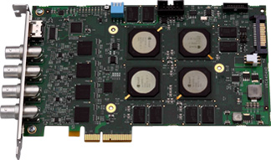
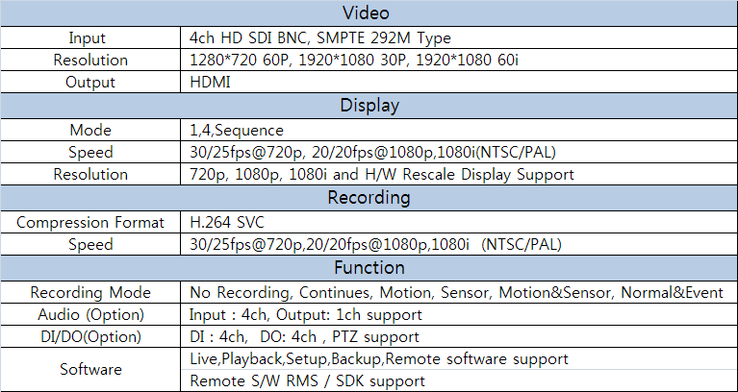
HD Board Spec
HDS Series
HDS-1204 4ch SDI Board
Key Features
4 channel high definition input using HD-CCTV Technology
Full 120 frames per second compression (NTSC)
H.264 Scalable Video CODEC for maximum flexibility
Embedded analytics to optimize compression efficiency
Key Benefits
Direct connection to high definition cameras using HD-CCTV technology
High definition image clarity and full frame rate encoding
Multi codec Intelligent Encoding
Easy integration with existing software for fast time to market
Specification
**System Specification can be changeable without notice

Slide 2
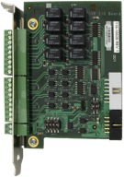
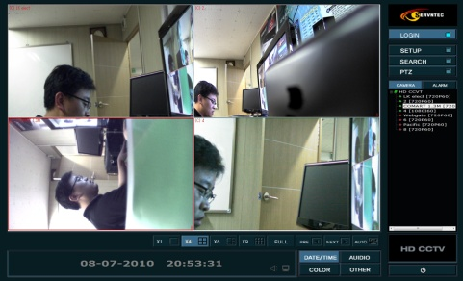
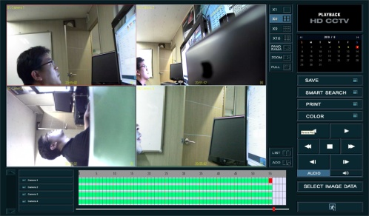
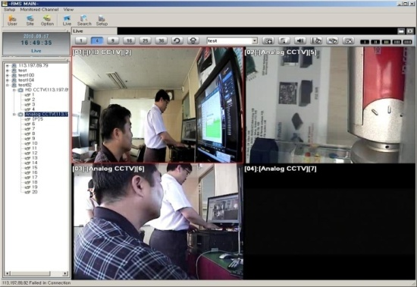
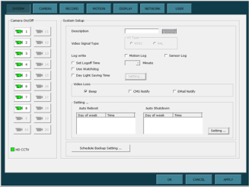
HD Board Spec
Option Part List
8ch DI/DO/PTZ
Option Board
PTZ
Option Board
Audio
Option Board
Software Feature
Live View
Playback
Setup
RMS Live View
#609,GoryoTech-On Bldg, 713 Gasan-Dong, Geumcheon-Gu, Seoul, Korea
Tel : +82-2-2614-4048 Fax : +82-2-2614-4066
E-Mail : sales@servntec.com Web : www.servntec.com
Service & Technology

Slide 3
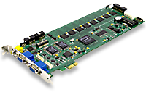
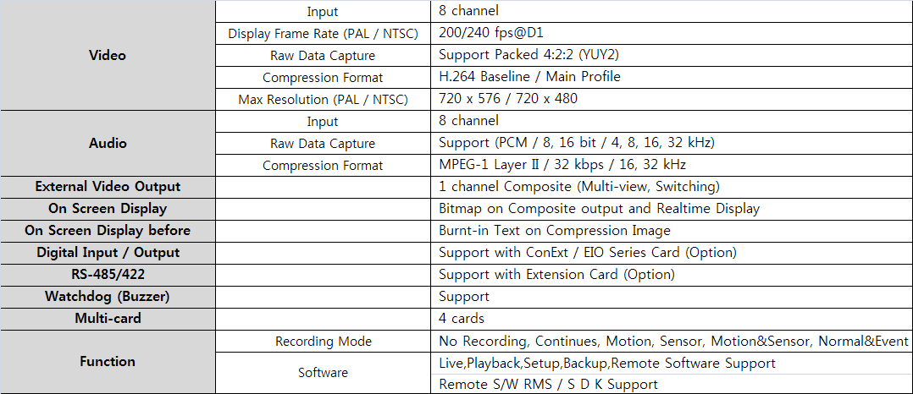
SDH - H DVR Board Spec
SDH – H Series
SDH-H2408 8ch Full D1 H.264 Board
240/240(PAL:200/200) Display/Recording
Key Features
8 channel D1 H.264 Hardware Compression
Video Input : 8 channel (PAL / NTSC)
Audio Input : 8 channel
Video Compression fps : 200/240 FPS@D1 (PAL / NTSC)
Support Real-time Display with OSD
External video output : 1 channel Composite (Multi-view, Switching)
Digital Input / Output, RS-485/422, Watchdog
Support Video-raw-data Capture
Support Multi-card Configuration (4 cards)
Specification
**System Specification can be changeable without notice

Slide 4
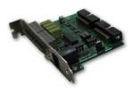
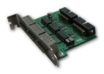
SDH - H DVR Board Spec
Option Part List
4ch Sensor Input / 4ch Output / PTZ Option Board
12ch Sensor Input Option Board
PTZ Board Option Board
Software Feature
Live View
Playback
Setup
RMS Live View
#609,GoryoTech-On Bldg, 713 Gasan-Dong, Geumcheon-Gu, Seoul, Korea
Tel : +82-2-2614-4048 Fax : +82-2-2614-4066
E-Mail : sales@servntec.com Web : www.servntec.com
Service & Technology

Slide 5
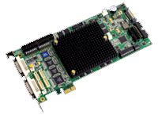
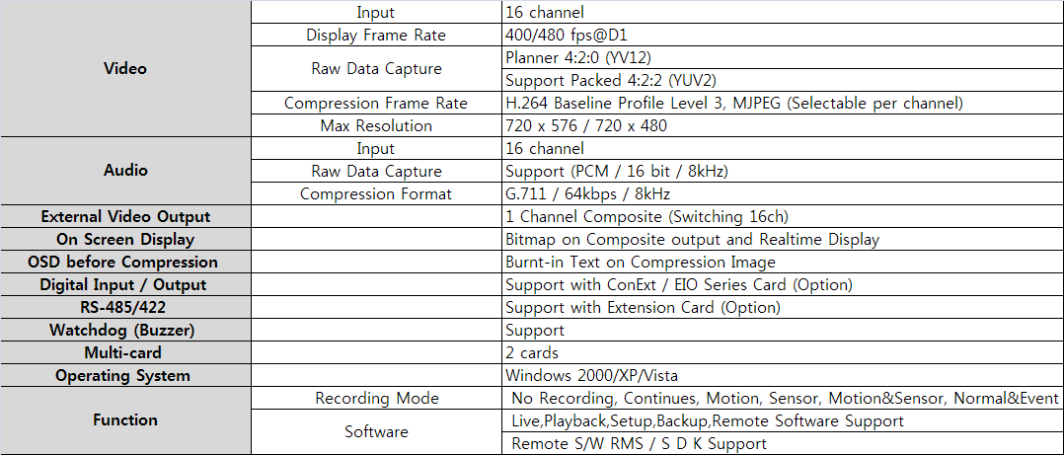
SDH - H DVR Board Spec
SDH – H Series
SDH-H4816 16ch Full D1 H.264 Board
480/480(PAL:400/400) Display/Recording
Key Features
16 channel D1 H.264 Hardware Compression
Video Input : 16 channel (PAL / NTSC)
Audio Input : 16 channel
Video Compression fps : 400/480 FPS@D1 (PAL / NTSC)
External video output : 1 channel Composite (Multi-view, Switching)
Digital Input / Output, RS-485/422, Watchdog
Support Video-raw-data Capture
Support Multi-card Configuration (2 cards)
Specification
**System Specification can be changeable without notice

Slide 6
SDH - H DVR Board Spec
Option Part List
4ch Sensor Input / 4ch Output / PTZ Option Board
12ch Sensor Input Option Board
PTZ Board Option Board
Software Feature
Live View
Playback
Setup
RMS Live View
#609,GoryoTech-On Bldg, 713 Gasan-Dong, Geumcheon-Gu, Seoul, Korea
Tel : +82-2-2614-4048 Fax : +82-2-2614-4066
E-Mail : sales@servntec.com Web : www.servntec.com
Service & Technology

Slide 7
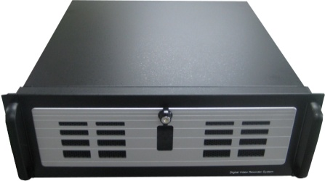
HD – CCTV PC DVR
HDS Series
HD SDI + Analog Type PC DVR 1080p, 720p H.264 Recording & Storage Using CCTV Coaxial Cable
Key Features
Support Coaxial cable based Megapixel Camera
Support Full HD Resolution(1920*1080) up to 8ch
Support Analog Full D1 Resolution up to 16ch
Full performance H.264 H/W Compression(16ch Analog & 8ch HD)
Support HD Progressive Scan
The Most stable & seamless file system
Real time PTZ Control (no signal delays)
S/W Feature
Reliability System
- Seamless file system(Image DB Basket )
- Various File Recovery Function
- Watch-Dog Function(S/W , H/W)
Versatility Playback
- Smart Search , Panorama, Bookmark
- Digital Zoom Support
Powerful Backup
- AVI/JPEG/BMP/Schedule/Concurrent
- Manual/Direct and Backup Viewer
Various Event Control(Notification)
- Automatic Remote Access
- Pop-up Viewer, Auto Alarm, E-Map
Web DVR
- Remote Live View , Playback & Search
- Remote PTZ control
External Dimension
480
180
550
<Upside>
<Beside>
180
<Front>

Slide 8
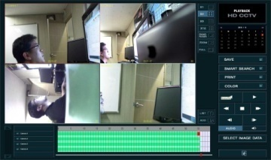
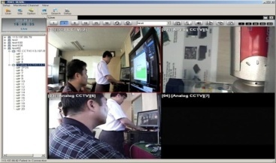
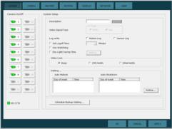
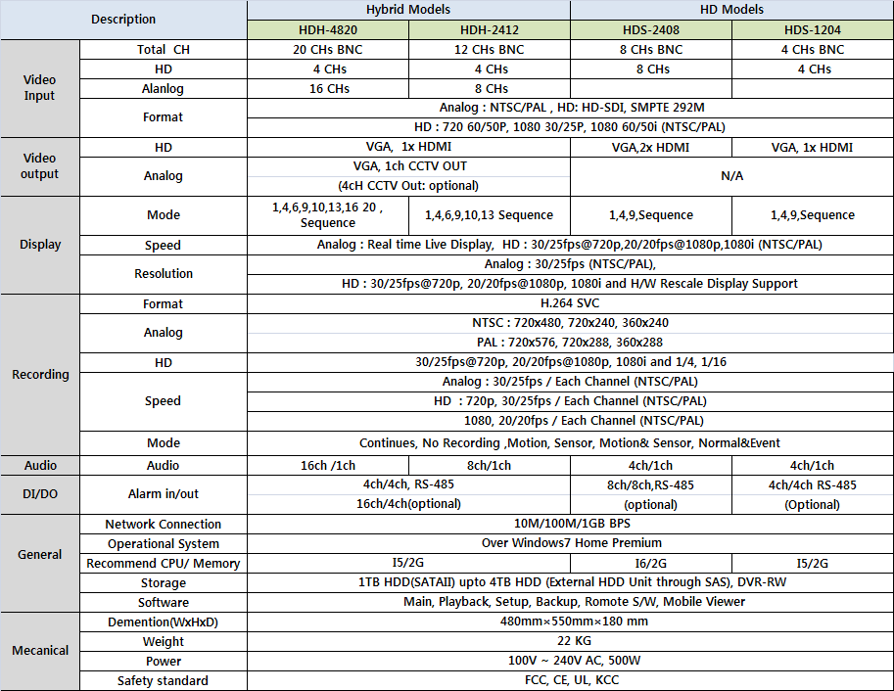
HD – CCTV PC DVR
Software Feature
Live View
Playback
RMS Live View
Setup
Specification
**System Specification can be changeable without notice
#609,GoryoTech-On Bldg, 713 Gasan-Dong, Geumcheon-Gu, Seoul, Korea
Tel : +82-2-2614-4048 Fax : +82-2-2614-4066
E-Mail : sales@servntec.com Web : www.servntec.com
Service & Technology

